Slide 1
Fe
Prof. K.R. Pande, Ph.D.

Slide 2
IRON
Iron is an essential micronutrient for almost all living organisms because of it plays critical role in metabolic processes such as DNA synthesis, respiration, and photosynthesis and biological nitrogen fixation.
Iron (Fe) is essential for crop growth and food production. Plants take up Fe as the ferrous (Fe²⁺) cation.
Although Fe is abundant in most well-aerated soils, the biological activity of iron is low because it primarily forms highly insoluble ferric compounds at neutral pH levels.
An imbalance between the solubility of iron in soil and the demand for iron by the plant are the primary causes of iron chlorosis.
Iron is a component of many enzymes associated with energy transfer, nitrogen reduction & fixation & lignin formation.
Many metabolic pathways are activated by iron, and it is a prosthetic group constituent of many enzymes.

Slide 3
Iron plays a significant role in various physiological and biochemical pathways in plants. It serves as a component of many vital enzymes such as cytochromes of the electron transport chain, and it is thus required for a wide range of biological functions.
In plants, iron is involved in the synthesis of chlorophyll, and it is essential for the maintenance of chloroplast structure and function.
without iron, a plant can’t produce chlorophyll, can’t get oxygen and won’t be green.
helps to carry important elements through a plant’s circulatory system.

Slide 4
There are seven approaches and combinations, which can be used to increase the concentration of iron in rice seeds.
The first approach involves enhancing iron accumulation in rice seeds by expressing the ferritin gene under the control of endosperm-specific promoters.
The second approach is to increase iron concentrations in rice through over expression of the nicotianamine synthase gene (NAS).
Nicotianamine, which is a chelator of metal cations, such as Fe⁺² and zinc (Zn⁺²), is biosynthesized from methionine via S-adenosyl methionine synthase.

Slide 5
The 3rd approach is to increase iron concentrations in rice and to enhance iron influx to seeds by expressing the Fe⁺²- nicotianamine transporter gene OsYSL2.
The 4th approach to iron biofortification involves enhancing iron uptake and translocation by introducing genes responsible for biosynthesis of mugineic acid family phytosiderophores (MAs).
The 5th approach to enhance iron uptake from soil is the over expression of the OsIRT1 or OsYSL15 iron transporter genes.

Slide 6
The 6th approach to enhanced iron uptake and translocation is overexpression of the iron homeostasis-related transcription factor OsIRO2. OsIRO2 is responsible for the regulation of key genes involved in MAs-related iron uptake.
The 7th approach to enhanced iron translocation from flag leaves to seeds utilizes the knockdown of the vacuolar iron transporter gene OsVIT1 or OsVIT2.

Slide 7
Fe sources: Iron for plants can come from a number of sources.
Ferric oxide is a chemical present in soil that gives dirt a distinctive red color, and plants can absorb iron from this chemical.
Iron is also present in decomposing plant matter, so adding compost to the soil or even allowing dead leaves to collect on the surface can help to add iron to the soil.

Slide 8
Fe involves to produce chlorophyll, which gives the plant oxygen as well as its healthy green color. This is why plants with an iron deficiency, or chlorosis, show a sickly yellow color to their leaves.
Iron is also necessary for some enzyme functions in plants.
Biological N fixation reduced due to Fe deficiency because Fe and Mo-Fe proteins are very important components of nitrogenase enzyme.
Conditions of Fe deficiency:
Alkaline Soil or too much lime added soil, Fe deficient soils
Correction: adding an iron fertilizer, adding garden sulfur.

Slide 9
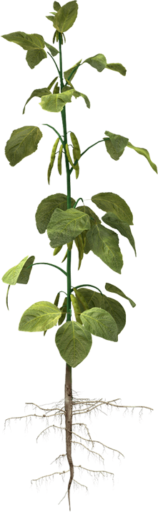
Metal Imbalances
Iron deficiencies may be caused by an imbalance with other metals such as copper (Cu), manganese (Mn) and molybdenum (Mo).
Chlorosis
Plants deficient in Fe will often display a pale green leaf color (chlorosis), with sharp distinction between green veins and yellow interveinal tissues.
Chlorophyll Formation
Iron is a catalyst to chlorophyll formation.
Oxygen Carrier
Iron acts as an oxygen carrier in the nodules of legume roots.
Solution of Fe deficiency
Foliar Sprays:Most Fe fertilizer sources works as foliar sprays.

Slide 10
MOLYBDENUM
Molybdenum (Mo) is a trace element found in the soil and is required for the synthesis and activity of the enzyme nitrate reductase.
Molybdenum is vital for the process of symbiotic nitrogen (N) fixation by Rhizobia bacteria in legume root nodules.
Molybdenum is utilized by selected enzymes to carry out redox reactions. Enzymes that require molybdenum for activity include nitrate reductase, xanthine dehydrogenase, aldehyde oxidase and sulfite oxidase.
Loss of Mo-dependent enzyme activity (directly or indirectly through low internal molybdenum levels) impacts upon plant development, in particular, those processes involving nitrogen metabolism and the synthesis of phytohormones abscisic acid & indole-3 butyric acid.

Slide 11
Nitrogenase, which is required for biological N₂ fixation by both asymbiotic and symbiotic nitrogen-fixing bacteria;
Nitrate reductase, which is required for the reduction of nitrate – this is necessary for the incorporation of nitrate-N in proteins; and
Xanthine dehydrogenase, which is involved in the synthesis of uric acid from purines.[

Slide 12
Deficiency Symptoms of Mo
Molybdenum deficiency symptoms in most plants are associated with a build-up of nitrate in the affected plant part. This is a result of poor nitrate reductase activity. Symptoms include:
pale leaves with interveinal and marginal chlorosis (yellowing) and necrosis (scald);
the whiptail disorder in Brassica crops (especially cauliflower);
decreased tasselling in maize;
premature germination of maize grain.
In legumes, inhibition of N₂ fixation may lead to pale, yellowing, nitrogen-deficient plants. The size and number of root nodules are often reduced.

Slide 13
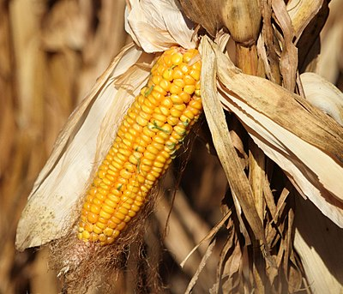
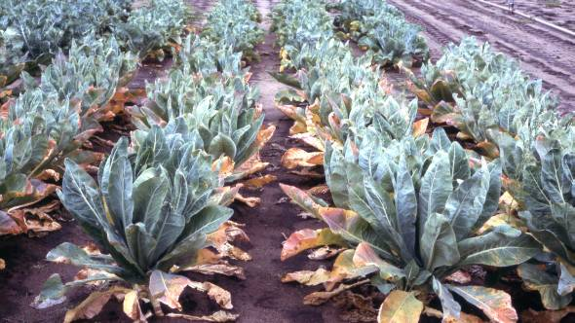

Slide 14
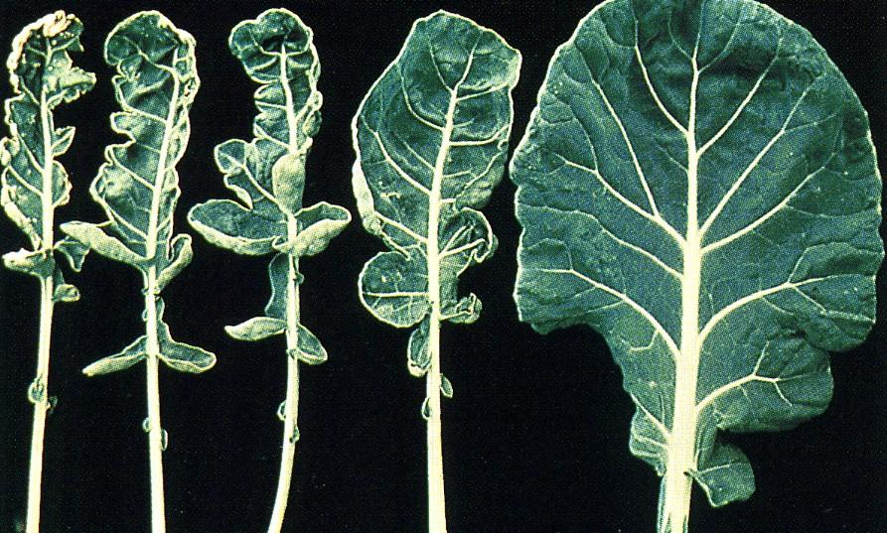
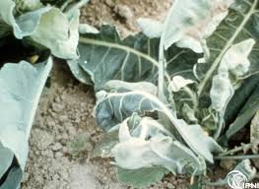

Slide 15
Soil conditions[edit]
Molybdenum deficiency is common in many different types of soil; Soils having low total Mo concentrations,
Soils with low plant-available Mo due to strong Mo sorption. Symptoms are most common where both conditions apply,
Soils such as in acid sandy soils. Molybdenum may be strongly sorbed in ironstone soils.
Liming of soils frequently relieves Mo deficiency by decreasing Mo sorption
Mo Compounds used as fertilizers include (in order of decreasing solubility): sodium molybdate, ammonium molybdate, molybdic acid, molybdenum trioxide, and molybdenum sulfide.
Typical soil and foliar application rates are 50–200 g Mo ha⁻¹; recommended rates for seed treatment range from 7–100 g Mo ha⁻¹.

Slide 16
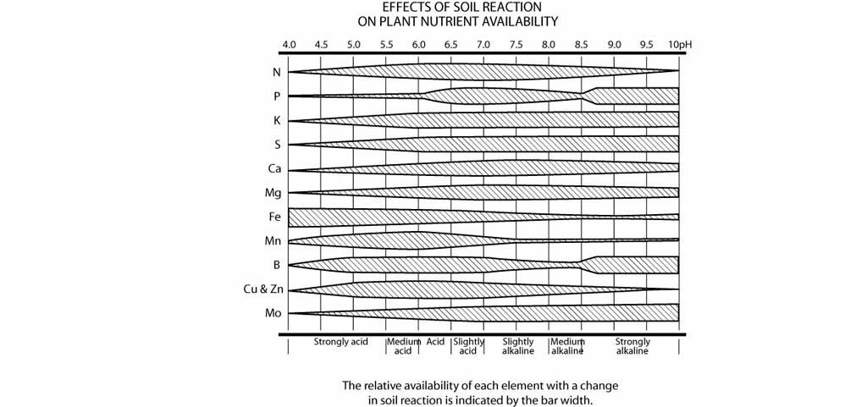

Slide 17
Zinc (Zn)
Zinc (Zn) is an essential micronutrient for plant life.
Zinc is essential for the normal healthy growth and reproduction of plants, animals and humans and when the supply of plant-available zinc is inadequate, crop yields are reduced and the quality of crop products is frequently impaired.

Slide 18
In plants, zinc plays a key role as a structural constituent or regulatory co-factor of a wide range of different enzymes and proteins in many important biochemical pathways and these are mainly concerned with:
carbohydrate metabolism,
both in photosynthesis and in the conversion of sugars to starch,
protein metabolism,
auxin (growth regulator) metabolism,
pollen formation,
the maintenance of the integrity of biological membranes,
the resistance to infection by certain pathogens

Slide 19
Deficiency of zinc can result in the plant developing visible symptoms of stress which might include one or more of the following:
stunting (reduced height),
interveinal chlorosis (yellowing of the leaves between the veins),
bronzing of chlorotic leaves,
small and abnormally shaped leaves and/or stunting and rosetting of leaves (where the leaves form a whorl on shortened stems).
In cases of marginal deficiency, plant yields can often be reduced by 20% or more without obvious visible symptoms. This is called ‘hidden’, ‘latent’ or ‘subclinical’ deficiency.

Slide 20
The soil conditions which most commonly give rise to deficiencies of zinc in crops can include one or more of the following:
low total zinc concentrations (such as sandy soils),
low pH, highly weathered parent materials with low total zinc contents (e.g. tropical soils),
high calcium carbonate content (calcareous soils),
neutral or alkaline pH (as in heavily limed soils or calcareous soils),
high salt concentrations (saline soils), v peat and muck (organic soils),
high phosphate status,
prolonged waterlogging or flooding (paddy rice soils),
high magnesium and/or bicarbonate concentrations in soils or irrigation water.

Slide 21
One application of between 20-30 kg ha-1 of zinc sulphate will often have an improving effect on the zinc status of the soil which will last for around five years before another application is required.
Zinc deficiency in humans affects physical growth, the functioning of the immune system, reproductive health and neurobehavioural development.
The compound is a zinc iron manganese copper magnesium ammonium polyphosphate with a composition of 9.85% ZnO, 3.70% Fe₂O₃, 2.03% MnO₂, 0.73% CuO, 0.49% MgO, 13.5% , 47.11% P₂O₅, and 3.10% H₂O.
Almost half of the world's cereal crops are grown on zinc-deficient soils & zinc deficiency in humans is widespread problem

Slide 22
Visible Zn deficiency symptoms include:
Chlorosis - yellowing of leaves; often interveinal; in some species, young leaves are the most affected, but in others both old and new leaves are chlorotic;
Necrotic spots - death of leaf tissue on areas of chlorosis;
Bronzing of leaves - chlorotic areas may turn bronze coloured;
Rosetting of leaves - zinc-deficient dicotyledons often have shortened internodes, so leaves are clustered on the stem;
Stunting of plants - small plants may occur as a result of reduced growth or because of reduced internode elongation;
Dwarf leaves ('little leaf') - small leaves that often show chlorosis, necrotic spots or bronzing;
Malformed leaves - leaves are often narrower or have wavy margins

Slide 23
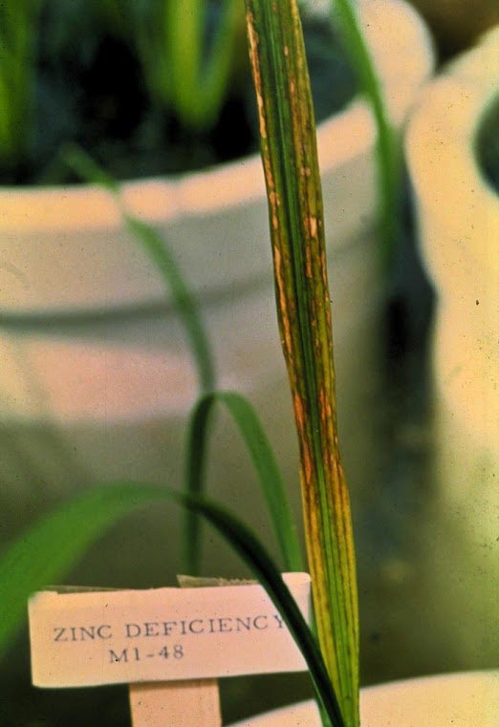

Slide 24
Zinc deficiency is associated with Sulfur deficiency.
It can occur in neutral and calcareous soils, intensively cropped soils, paddy soils and very poorly drained soils, sodic and saline soils, peat soils, soils with high available Phosphorus (P) and Silicon (Si) status, sandy soils, highly weathered, acid, and coarse-textured soils, soils derived from serpentine and laterite, and leached, old acid sulfate soils with a small concentration of Potassium (K), Magnesium (Mg), and Calcium (Ca).

Slide 25
Zn deficiency can also be caused by one or more of the following factors:
small amount of available Zn in the soil.
planted varieties are susceptible to Zn deficiency (i.e., Zn-inefficient cultivars).
high pH (close to seven or alkaline under anaerobic conditions). Solubility of Zn decreases by two orders of magnitude for each unit increase in pH. Zn is precipitated as sparingly soluble Zn(OH)₂ when pH increases in acid soil following flooding.
high HCO₃- concentration because of reducing conditions in calcareous soils with high organic matter content or because of large concentrations of HCO₃- in irrigation water.
depressed Zn uptake because of an increase in Iron (Fe), Ca, Mg, Copper (Cu), Manganese (Mn), and P after flooding.
formation of Zn-phosphates following large applications of P fertilizer. High P content in irrigation water (only in areas with polluted water).
formation of complexes between Zn and organic matter in soils with high pH and high organic matter content or because of large applications of organic manures and crop residues.
precipitation of Zn as ZnS when pH decreases in alkaline soil following flooding.
excessive liming.
wide Mg:Ca ratio (i.e., >1) and adsorption of Zn by CaCO₃ and MgCO₃. Excess Mg in soils derived from ultrabasic rocks.

Slide 26
How to identify
Symptoms appear between two to four weeks after transplanting. Check the field for the following symptoms:
dusty brown spots on upper leaves of stunted plants
uneven plant growth and patches of poorly established hills in the field, but the crop may recover without intervention
increased spikelet sterility in rice
chlorotic midribs, particularly near the leaf base of younger leaves
leaves lose turgor and turn brown as brown blotches and streaks appear on lower leaves, enlarge, and coalesce
white line sometimes appears along the leaf midrib
leaf blade size is reduced

Slide 27
Zinc (Zn) deficiency
Zinc (Zn) deficiency affects several biochemical processes in the rice plant, thus severely affecting plant growth.
It can occur in
neutral and calcareous soils,
intensively cropped soils,
paddy soils and very poorly drained soils,
sodic and saline soils, peat soils,
soils with high available Phosphorus (P) and Silicon (Si) status,
sandy soils,
highly weathered and coarse-textured soils,
and leached, old acid sulfate soils with a small concentration of Potassium (K), Magnesium (Mg), and Calcium (Ca).
small amount of available Zn in the soil.
high pH (close to seven or alkaline under anaerobic conditions). Solubility of Zn decreases by two orders of magnitude for each unit increase in pH. Zn is precipitated as sparingly soluble Zn(OH)₂ when pH increases in acid soil following flooding.
high HCO₃- concentration because of reducing conditions in calcareous soils with high organic matter content or because of large concentrations of HCO₃- in irrigation water.

Slide 28
Zinc (Zn) deficiency
high HCO₃- concentration because of reducing conditions in calcareous soils with high organic matter content or because of large concentrations of HCO₃- in irrigation water.
depressed Zn uptake because of an increase in Iron (Fe), Ca, Mg, Copper (Cu), Manganese (Mn), and P after flooding.
formation of Zn-phosphates following large applications of P fertilizer. High P content in irrigation water (only in areas with polluted water).
formation of complexes between Zn and organic matter in soils with high pH and high organic matter content or because of large applications of organic manures and crop residues.
precipitation of Zn as ZnS when pH decreases in alkaline soil following flooding.
excessive liming.wide Mg:Ca ratio (i.e., >1) and adsorption of Zn by CaCO₃ and MgCO₃. Excess Mg in soils derived from ultrabasic rocks.
Zinc deficiency is the most widespread micronutrient disorder in rice. Its occurrence has increased with the introduction of modern varieties, crop intensification, and increased Zn removal.
How to identify
In paddy, Symptoms appear between two to four weeks after transplanting. symptoms:
1. dusty brown spots on upper leaves of stunted plants 2.uneven plant growth and patches of poorly established hills in the field, but the crop may recover without intervention
increased spikelet sterility in rice 3.chlorotic midribs, particularly near the leaf base of younger leaves 4. leaves lose turgor and turn brown as brown blotches and streaks appear on lower leaves, enlarge, and coalesce white line sometimes appears along the leaf midrib 5.leaf blade size is reduced
Under severe Zn deficiency, tillering decreases and can stop completely and time to crop maturity increases.
Other effects on growth include the following:
Symptoms may be more pronounced during early growth stages because of Zn immobilization (due to increased bicarbonate concentration in the soil under strongly reducing conditions following flooding). If the deficiency is not severe, plants can recover after 4−6 weeks, but maturity is delayed and yield reduced.
Zinc deficiency has similar symptoms as Iron (Fe) deficiency (also occurs on alkaline soils), Fe toxicity (leaf spots, appearance), grassy stunt virus, and tungro virus.
Compared with Zn deficiency, Fe toxicity occurs on high organic status soils with low pH.
To confirm Zn deficiency, send soil and plant sample to the laboratory for testing.
Why is it important
In Japan, Zn deficiency is the cause of the "Akagare Type II" disorder in rice. Its damage is important throughout the growth cycle of the crop.
How to manage
Preventing Zn deficiency is an intricate part of general crop management. The following are the general measures to prevent Zn deficiencies:
Grow Zn-efficient varieties. Contact your local agriculture office for an up-to-date list of available varieties.
Use fertilizers that generate acidity (e.g., replace some urea with ammonium sulfate).
Apply organic manure before seeding or transplanting or applied to the nursery seedbed a few days before transplanting.
Allow permanently flooded fields (e.g., where three crops per year are grown) to drain and dry out periodically.
Monitor irrigation water quality.
Where possible,
Broadcast ZnSO₄ in nursery seedbed
Dip seedlings or presoak seeds in a 2−4% ZnO suspension (e.g., 20−40 g ZnO L⁻¹ H₂O)

Slide 29
Zinc (Zn) deficiency
high HCO₃- concentration because of reducing conditions in calcareous soils with high organic matter content or because of large concentrations of HCO₃- in irrigation water.
depressed Zn uptake because of an increase in Iron (Fe), Ca, Mg, Copper (Cu), Manganese (Mn), and P after flooding.
formation of Zn-phosphates following large applications of P fertilizer. High P content in irrigation water (only in areas with polluted water).
formation of complexes between Zn and organic matter in soils with high pH and high organic matter content or because of large applications of organic manures and crop residues.
precipitation of Zn as ZnS when pH decreases in alkaline soil following flooding.
excessive liming.wide Mg:Ca ratio (i.e., >1) and adsorption of Zn by CaCO₃ and MgCO₃. Excess Mg in soils derived from ultrabasic rocks.
Zinc deficiency is the most widespread micronutrient disorder in rice. Its occurrence has increased with the introduction of modern varieties, crop intensification, and increased Zn removal.
How to identify
Symptoms appear between two to four weeks after transplanting. Check the field for the following symptoms:
dusty brown spots on upper leaves of stunted plants
uneven plant growth and patches of poorly established hills in the field, but the crop may recover without intervention
increased spikelet sterility in rice
chlorotic midribs, particularly near the leaf base of younger leaves
leaves lose turgor and turn brown as brown blotches and streaks appear on lower leaves, enlarge, and coalesce
white line sometimes appears along the leaf midrib
leaf blade size is reduced
Under severe Zn deficiency, tillering decreases and can stop completely and time to crop maturity increases.
Other effects on growth include the following:
Symptoms may be more pronounced during early growth stages because of Zn immobilization (due to increased bicarbonate concentration in the soil under strongly reducing conditions following flooding). If the deficiency is not severe, plants can recover after 4−6 weeks, but maturity is delayed and yield reduced.
Zinc deficiency has similar symptoms as Iron (Fe) deficiency (also occurs on alkaline soils), Fe toxicity (leaf spots, appearance), grassy stunt virus, and tungro virus.
Compared with Zn deficiency, Fe toxicity occurs on high organic status soils with low pH.
To confirm Zn deficiency, send soil and plant sample to the laboratory for testing.
Why is it important
In Japan, Zn deficiency is the cause of the "Akagare Type II" disorder in rice. Its damage is important throughout the growth cycle of the crop.
How to manage
Preventing Zn deficiency is an intricate part of general crop management. The following are the general measures to prevent Zn deficiencies:
Grow Zn-efficient varieties. Contact your local agriculture office for an up-to-date list of available varieties.
Use fertilizers that generate acidity (e.g., replace some urea with ammonium sulfate).
Apply organic manure before seeding or transplanting or applied to the nursery seedbed a few days before transplanting.
Allow permanently flooded fields (e.g., where three crops per year are grown) to drain and dry out periodically.
Monitor irrigation water quality.
Where possible,
Broadcast ZnSO₄ in nursery seedbed
Dip seedlings or presoak seeds in a 2−4% ZnO suspension (e.g., 20−40 g ZnO L⁻¹ H₂O)

Slide 30
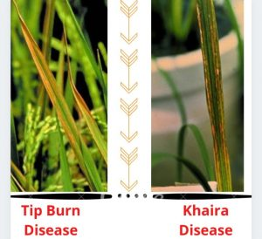

Slide 32
