Slide 1
Organic farming
Ananta Prakash Subedi
Asst. Prof.
DACE, FoA
AFU, Bharatpur

Slide 2
Content
Introduction to Organic Agriculture
  definition
  history
  comparison with conventional
  principle
Economics of Organic Agriculture (in next lecture)

Slide 3
Global Organic Movement
Organic-1.0
Discovery Phase
1920s
Organic-2.0
Codified ideas into standards
1970s
Organic-3.0
Organic systems as a part of the multiple solutions
2015
Notes:
Organic 3.0 is about bringing organic out of its current niche into the mainstream and positioning organic systems as part of the multiple solutions. Until now, though, organic has not been included - or inclusive - enough to contribute these solutions on a global scale. The Organic 3.0 concept seeks to provide inclusive and sustainable

Slide 4
Definition
Organic farming is a system which avoids or largely excludes the use of synthetic inputs (such as fertilizers, pesticides, hormones, feed additives etc) and to the maximum extent feasible rely upon crop rotations, crop residues, animal manures, off-farm organic waste, mineral grade rock additives and biological system of nutrient mobilization and plant protection.
"Organic Agriculture is a production system that sustains the health of soils, ecosystems and people. It relies on ecological processes, biodiversity and cycles adapted to local conditions, rather than the use of inputs with adverse effects. Organic Agriculture combines tradition, innovation and science to benefit the shared environment and promote fair relationships and a good quality of life for all involved." (IFOAM, 2005)
"Organic agriculture is a holistic production management system which promotes and enhances agro-ecosystem health, including biodiversity, biological cycles, and soil biological activity. It emphasizes the use of management practices in preference to the use of off-farm inputs, taking into account that regional conditions require locally adapted systems. This is accomplished by using, where possible, agronomic, biological, and mechanical methods, as opposed to using synthetic materials, to fulfil any specific function within the system." (FAO/WHO Codex Alimentarius Commission, 1999).

Slide 5
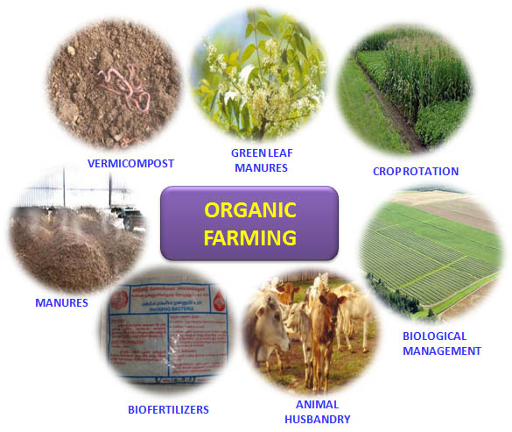

Slide 6
History of organic farming
Prior to 20th century almost all farming was organic
  Synthetic pesticides and fertilizer were the new “non organic” elements
The term “organic farming” coined by Lord Northbourne in his book “Look to the Land” published in 1940
Key events
  1950s JI Rodale – “organic growing”
  “Silent Spring” 1962
  California Certified Organic Farmers 1973
  USDA National Organic Program 2002

Slide 7
Brief History of Organic Farming in Nepal
Organized movement of OA started since 1986
Institute for Sustainable Agriculture Nepal (INSAN), a national NGO initiated first and gradually several NGO started professionally in organic agriculture
OA first appeared as one of the priority sectors in the 10th five year plan (2003-2008)
Currently OA is a major subject of discussion among scientists, development workers, farmers, traders, researchers and policy makers

Slide 8
Organic Agriculture in Nepal
Institute for Sustainable Agriculture Nepal
Nepal Permaculture Group
Organic farm in Gamchha, Bhaktapur
1992
1987
1986
Notes:
For the first time, organic agriculture activities were initiated in Nepal in 1986 by an NGO: Institute for Sustainable Agriculture Nepal (INSAN) followed by Judith chase, US citizen who started an organic farm in Gamchha, Bhaktapur in 1987 to promote organic vegetable production. The Nepal Permaculture Group- a national organization working on organic sector playing a lead role in organic agriculture movement in Nepal since 1992.

Slide 9
Organic agriculture in Nepal
National Agriculture policy, 2004 (राष्ट्रिय कृषि निति, २०६१)
4.3 Development of a Commercial and Competitive Farming System
In Preamble 4.3.5 Organic farming shall be encouraged. Necessary support shall be provided for the certification of the standard of exportable agricultural products produced in production areas based on organic farming.

Slide 10
Organic agriculture in Nepal
National standards of OA production and processing, 2005 - revised edition published on February 19, 2013.
प्राङ्गरिक कृषि उत्पादन तथा प्रशोधन प्रणालीको राष्ट्रिय प्राविधिक मापदण्ड सम्वन्धी निर्देशिका, २०६४
2008
First national workshop on organic farming
DADO, Jumla started OA
National Exhibition on Organic Products
2007
2006

Slide 11
Policy towards OA
Government adopted some acts like:
Pesticides Act (1991), Pesticides Regulation (1994), Environment Protection Act and Environmental Protection Regulation (1997).
Government prioritized first “OA” in 10th five year plan (2003-2008) and then onwards.
Recently Ministry of Agriculture and Cooperative has developed a guideline for organic agriculture.

Slide 12
Organic Agriculture in Nepal
2017-2020
जैबिक तथा वानस्पतिक बिषादी उत्पादन, प्रयोग तथा अनुदान निर्दशिका, २०७४
प्राङ्गारिक कृषि प्रवर्द्धन कार्यविधि २०७५
रैथाने बाली प्रवर्द्धन तथा संरक्षण कार्यक्रम कार्यान्वयन कार्यविधि, २०७५
प्राङ्गारिक कृषि प्रवर्द्धन कार्यक्रम सञ्चालन प्रक्रिया, २०७७
आगामी १० वर्षमा सिङ्गो देशलाई पूर्ण प्राङ्गारिक घोषणा गर्ने (हाल सत्तासीन दलको घोषणापत्र, २०७४)

Slide 13
Achievements-1)Policies
राष्ट्रिय कृषि निति, २०६१
प्राङ्गरिक कृषि उत्पादन तथा प्रशोधन प्रणालीको राष्ट्रिय प्राविधिक मापदण्ड सम्वन्धी निर्देशिका, २०६४
प्राङ्गारिक मल अनुदान निर्देशिका, २०६८,
प्राङ्गारिक तथा जैबिक मल नियमन कार्यबिधि, २०६८
प्राङ्गारिक कृषि उत्पादनको सामूहिक प्रमाणीकरणका लागि आन्तरिक नियन्त्रण प्रणाली निर्दशिका, २०६९
प्राङगारिक कृषि उत्पादनको सहभागीताम्क गुणस्तर निर्धारण प्रणाली (पि जि एस) संचालन सम्बन्धि मार्गदर्शन, २०६९
राष्ट्रिय प्राङगारीक कृषि सम्बन्धन प्रदायक निकायको सम्बन्धन प्रदान गर्ने सम्बन्धमा ब्यवस्था गर्न बनेको कार्यबिधि, २०६९
जैबिक तथा वानस्पतिक बिषादी उत्पादन, प्रयोग तथा अनुदान निर्दशिका, २०७४
प्राङ्गारिक कृषि प्रवर्द्धन कार्यविधि २०७५
रैथाने बाली प्रवर्द्धन तथा संरक्षण कार्यक्रम कार्यान्वयन कार्यविधि, २०७५
प्राङ्गारिक कृषि प्रवर्द्धन कार्यक्रम सञ्चालन प्रक्रिया, २०७७

Slide 14
Achievements-2) Networking
Research
Government sector
Extension
Government sector DoA, Tea and Coffee Development Board, Kathmandu Metropolitan
Production
Government sector=0
Education
NARDF, NARC, NAST, IAAS, AFU
Non-government sector
Nepal Permaculture Group, SECARD, HASERA
Government institution IAAS, AFU
Private sector Mid-west Collage of Organic Agriculture
Non-government sector SSMP, Winrock International, ECOCENTER, HOPTA and AEC
Non-government sector (FG, cooperatives, companies and private firms, CBOs
OA

Slide 15
Achievements-3) Share in organic market
Area | Major exported organic products | Producer | Processor | Exporter | Importer
9892 ha (14% increased compared to 2008 | Tea, coffee, Ginger, chili | 247 | 4 | 4 | 0
Source: FAO, 2011
Organic agriculture is getting wider attention from Government, private sector, NGOs and farmers
Organic farming in Nepal is gradually increasing in terms of area coverage and production Many agricultural commodities are being produced organically and some of them exported to the international market
Many organic growers producing different organic crops either individually or collectively through farmers' group or cooperatives.

Slide 16
Achievement-4) Institutional arrangement for OA Certification
MoALD
Certifying agencies in Nepal
National Association of Sustainable Agriculture Australia (NASAA),
Institute for Marketecology (IMO, Switzerland), Ethical and Environmental Certification Institute (ICEA, Italy), Ecocert France, OneCert America, Organic Certification Nepal
National Coor. Com. On OA Production and Processing
Desk Unit (DU)
National Technical Committee (NTC)
National OA Accreditation Body (NOAAC)
Autonomous
Certifying Agencies
Inspectors
Certification
Organic producer/processor
Organic Traders
Producers/Traders Association

Slide 17
Achievements-5)Capacity Building
Capacity building for government staffs, organic producers, through trainings (certification, organic production, inspection, TOT in OA, etc)
Certification support to organic producers, farmers groups
Preparation of Training Manuals: OA, ICS and PGS
Initiation and promotion of Organic farmers markets

Slide 18
Achievements-6)Advocacy & Awareness
Organize National Exhibition on Organic Products (each year)
National workshop (purposed)
National Organic Trade Fair (purposed)
Institutional arrangement (at MoALD, Separate OA desk)

Slide 19
Production, Certification and Marketing
Kanchajanga Tea state | Orthodox black and green tea, large cardamom, ginger, lemon grass | 1997 | NASAA, Australia | USA, Japan, Germany, Austria, Poland, Spain, Austria, India
Guranse Tea State | Orthodox tea | 2000 | NASAA, Australia | Japan, Germany, USA
Shambala Herbal | Essential oil | 2000 | NASAA, Australia | Germany
Annapurna Organic | Coffee, spices and honey | 2004 | NASAA, Australia | Canada, Japan
Male Fashion | Essential oil | 2003 | ECOCERT, Belgium | Belgium
Gulmi Cooperative | Coffee | 2004 | NASAA, Australia | Japan

Slide 20
Nutrients and soil fertility
Organic
Crop rotation
Green Manure, cover crops plowed under
Compost, animal and vegetable
Also commonly allowed are rock phosphate, greensand, sulfur, lime and some other natural compounds
Conventional
Artificial fertilizers primarily produced from ammonia via natural gas
All methods of organic farming are practiced to some extent in conventional farms

Slide 21
Weed control
Organic
Crop rotation
Tillage and cultivation including hand weeding
Mowing
Row covers
Flame and thermal weeding
Mulching
Conventional
Tillage and cultivation
Synthetic herbicides

Slide 22
Pest control
Organic
Integrated Pest Management
Crop rotation
Tillage and cultivation
Interplanting
Row covers
Naturally occurring pesticides, bacillus thuringiensis, rotenone, pyrethrum
Conventional
Synthetic pesticides
GM crops
All methods used in organic farming

Slide 23
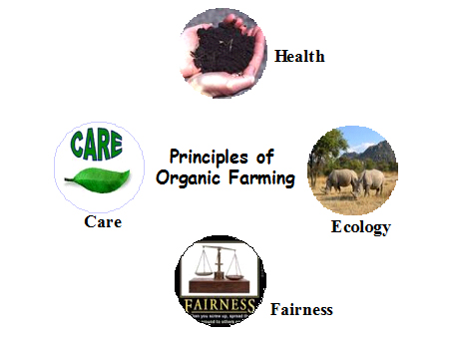
ORGANIC FARMING PRINCIPLE

Slide 24
Principle of O.A. contd…
These Principles are the roots from which organic agriculture grows and develops. They express the contribution that organic agriculture can make to the world, and a vision to improve all agriculture in a global context.
Agriculture is one of humankind’s most basic activities because all people need to nourish themselves daily. History, culture and community values are embedded in agriculture. The Principles apply to agriculture in the broadest sense, including the way people tend soils, water, plants and animals in order to produce, prepare and distribute food and other goods. They concern the way people interact with living landscapes, relate to one another and shape the legacy of future generations.
The Principles of Organic Agriculture serve to inspire the organic movement in its full diversity. Furthermore, they are presented with a vision of their world-wide adoption.

Slide 25
contd…
Principle of Health:
Organic Agriculture should sustain and enhance the health of soil, plant, animal, human and planet as one and indivisible.
Principle of Ecology:
Organic Agriculture should be based on living ecological systems and cycles, work with them, emulate them and help sustain them.

Slide 26
contd…
Principle of Fairness
Organic Agriculture should build on relationships that ensure fairness with regard to the common environment and life opportunities.
Principle of Care
Organic Agriculture should be managed in a precautionary and responsible manner to protect the health and well-being of current and future generations and the environment.

Slide 27
Basic Steps of Organic Farming
Organic farming approach involves following five principles:
1. Conversion of land from conventional management to organic management.
2. Management of the entire surrounding system to ensure biodiversity and sustainability of the system.
3. Crop production with the use of alternative sources of nutrients such as crop rotation, residue management, organic manures and biological inputs.
4. Management of weeds and pests by better management practices, physical and cultural means and by biological control system
5. Maintenance of live stock in tandem with organic concept and make them an integral part of the entire system.

Slide 28
THE END

