Slide 1
Economics of Organic Agriculture
Ananta Prakash Subedi

Slide 2
What is organic agriculture?

Slide 3
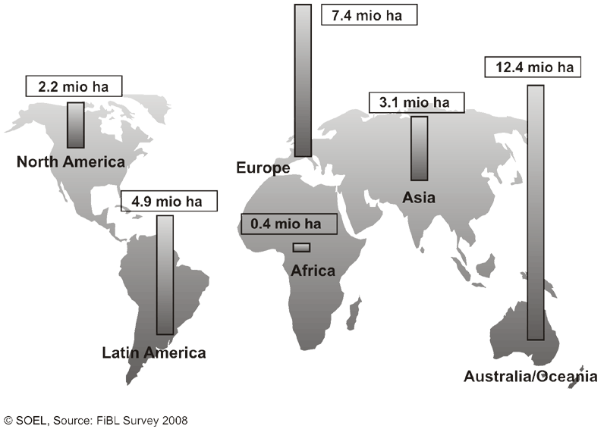
Certified organic production: over 30 million hectares, 138+ countries

Slide 4
OA to Nepal
Until the 1950s Nepalese farming systems were largely organic. Introduction of green revolution agriculture in South Asia persuaded Nepal to use agrochemicals.
In recent years, reflecting the growing understanding of the adverse impacts of chemical-based agriculture on health and the environment, organic farming is regaining some of its popularity among the farmers, academicians and entrepreneurs.
However, the organized organic market in Nepal is very small. The International Federation of Organic Agriculture Movement reports that 9789 ha (0.23% percent of total agricultural land) of land is managed by 1470 producers in Nepal under organic farming (IFOAM, 2012).
Further, about 90 metric tons of certified organic coffee is produced in some 210 ha of land and 59 ha are under conversion (Shrestha, 2011). About 7 percent of traditional tea produced in Nepal is organic.

Slide 5
Organic farmers diversify their businesses by growing several crops at one time, often having both livestock and field crops, and sometimes value-added enterprises as well. The diversification reduces economic risk.
Many experienced organic farmers have crop yields as high as, or higher than, the average conventional yields. However, the average organic crop yields are often lower than the average conventional yields.

Slide 6
Cost of production
Organic farms have lower costs of production than conventional farms, with much less emphasis on purchased inputs. Synthetic fertilizer and pesticide purchases are eliminated, and costs of purchased feed, veterinary bills, and replacement livestock are lower. In addition, organic farmers have lower fixed (overhead) costs for depreciation and interest charges attached to capital inputs, such as machinery and equipment. On balance, input costs are lower on organic farms.
Organic farming methods replace herbicides with mechanical cultivation and other management practices to provide weed control. Tillage for weed control after plant emergence is relatively shallow with low potential to compact the soil.
Some argue that weed control increases tillage requirements and costs. In practice, this has not been the case. By improving soil structure and with good management practices, organic farmers have discovered that they require no more, and in some cases less, tillage than their conventional neighbors.

Slide 7
Net farm income
The net income of organic farms appears to be slightly higher than for conventional farms. In general, expenses are lower and the income is greater (if there is good price premium).
Price premiums vary between crops and over time. The organic industry is changing rapidly, leading to price instability. For example, a high premium price for one crop can lead many farmers to grow that crop. The market is then flooded and the price plummets.
Many believe that over time, the price premiums will stabilize. The high value of organic crops is offset by including lower-value crops in rotation. Green manures and pasture crops, though valuable in their soil improvement ability, do not generate high economic returns.
Intercropping is one way to incorporate low-value crops into the rotation, while still growing valuable cash crops. Crop rotations also reduce risk. By growing several crops at any one time, the farm income will be buffered from both price fluctuations in any one crop and crop failure.

Slide 8
Marketing
The demand for organically-produced foods is growing rapidly, in Canada, North America, Japan and Europe. This rapid growth has resulted in fluctuations in the market.
For example, some of the markets have very specific demands in terms of crop quality and the demands change from year to year.
The organic industry is still developing, and the infrastructure in terms of transportation systems, wholesalers and distributers is in its infancy.

Slide 9
Economic benefits
Net income = (price x quantity) – total costs
Generally, organic farmers earn more.

Slide 10
Food security benefits
Higher incomes
Higher yields
Diversified production
Improved nutrition

Slide 11
Environmental Benefits
Less pollution
Improved soil, incl. increased water retention and less soil erosion
Enhanced biodiversity
No genetic contamination

Slide 12
Environmental Benefits, cont’d
Mitigated climate change
Reduced energy consumption
Landscape services

Slide 13
Social & cultural benefits
Benefits for smallholders
Women’s empowerment
Builds on traditional knowledge
Reduced rural-urban migration
Improved health & safety
Community revitalization

Slide 14
OA as an export opportunity—rapid global market growth

Slide 15
OA as an export opportunity
Global sales growth rates at least double those of conventional food products
Acute supply shortages since 2005
Developing country exports rising fast
Price premiums

Slide 16
Regional Distribution of Organic Food Sales 2006
Region Billion USD %
Western Europe 20.0 52
North America 17.3 45
Asia 0.78 2
Oceania/Australia 0.34 1
TOTAL 38.6
Source: Sahota (2008)

Slide 17
Regional Distribution of Organic Food Sales 2006

Slide 18
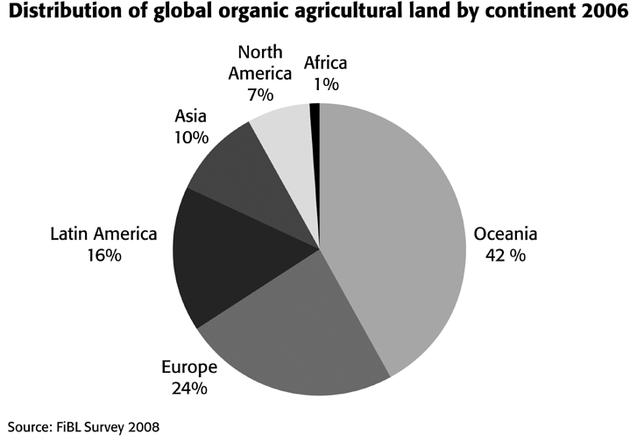
Regional distribution of certified organic production 2006

Slide 19
Production challenges
Little or no government support (policies, ag extension, R&D)
Conversion period
Knowledge intensive
Sometimes lack of organic inputs
Lack of secure land tenure

Slide 20
Export challenges
OA exports must:
Meet Sanitary and Phytosanitary (SPS) requirements in import mkt (same as for convent’l products)
Meet requirements of OA regulations & be certified by approved cert. body
Meet additional requirements of private standards (sometimes)

Slide 21
Export challenges
Agric. Subsidies in import markets
Need for market information
Consumer preferences for local food
Lack of harmonization, equivalence & mutual recognition

Slide 22
Status of Nepal on OA
Rice: Conventional farming is more productive and offers significantly higher profits relative to organic rice farming. The average cost of production of organic rice is higher than in conventional production. Labor productivity is higher in conventional rice relative to organics even though both types of farmers make net positive profits .
Maize: While there are no significant differences in yield, both organic and conventional maize farms have negative profits in due to low productivity and high labor costs. However, the negative profits are significantly smaller in organic maize relative to conventional farming. Organic maize farms have significantly lower costs relative to conventional farms.

Slide 23
Tea: Conventional tea productivity is higher than organic tea productivity, but there are no significant differences in profits. Productivity may be lower in organic tea because of inadequate supply of organic manure. Farmers note that organic tea flowering or flushing is slower and leaves are more difficult to pluck in comparison to conventional farming, where new growth is succulent and easy to pluck. While production costs of conventional tea, in terms of fertilizers and pesticides are higher, this is offset by higher labor costs in organic production. The higher price organic tea fetches does not make up for the high cost of production and there is no significant differences in profits.
Coffee: Profits in organic and conventional farms are negative. However, net revenues in organic coffee farming are significantly higher than conventional coffee. While there is no significant difference in yields between the two types of coffee, conventional coffee is significantly more costly to produce. This is because of the high costs of fertilizers and pesticides used .

Slide 24
Cauliflower: There are no significant differences in productivity or profits between conventional and organic cauliflower. This may be partially because organic producers do not get a premium price for their product, in spite of growing awareness about the health hazards of consuming vegetables subject to high doses of pesticides. The average cost of production of organic cauliflower is lower on an acreage basis, but higher in terms of per unit cost.

Slide 25
What Nepal should do for developing OA?
Assess national organic sector & policies
OA action plan
Consider supporting OA R&D, extension services, certification costs, development of domestic market, exports, harmonization

Slide 26
Other factors contributing to success
Community organization
Group certification

Slide 27
Thank you!

