Slide 1
Soil Fertility and Management for Organic Agriculture
Ananta Prakash Subedi

Slide 2
Topics in discuss
Soil Management (for few days)
Then we go for:
Weed and Pest Management
Cropping system in organic farming

Slide 3
Building Soil Quality and Managing Nutrients:
“Feed the Soil, and the Soil will Feed the Crop”

Slide 4
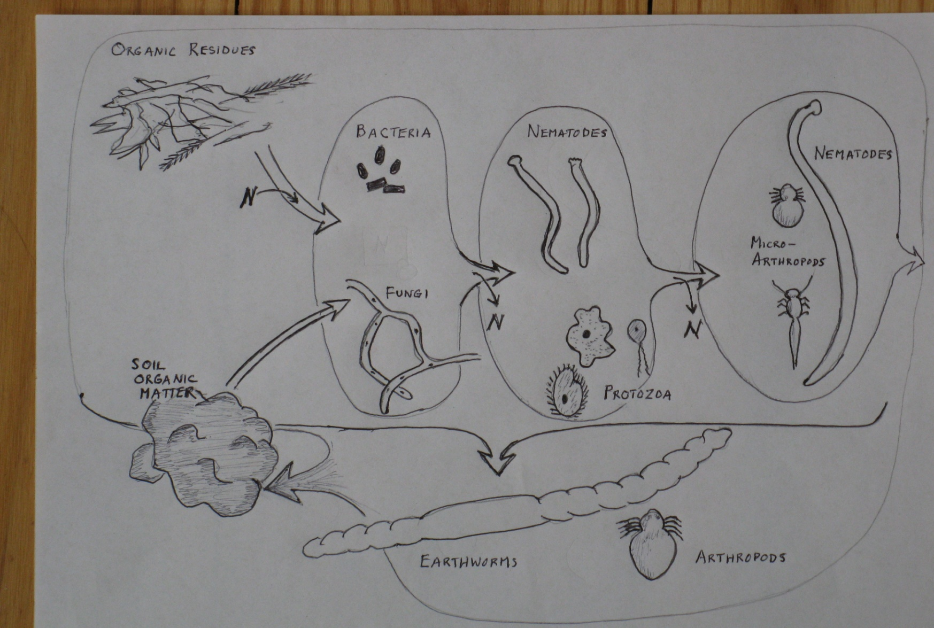
The Soil is a Living System
Key elements of the Soil Food Web

Slide 5
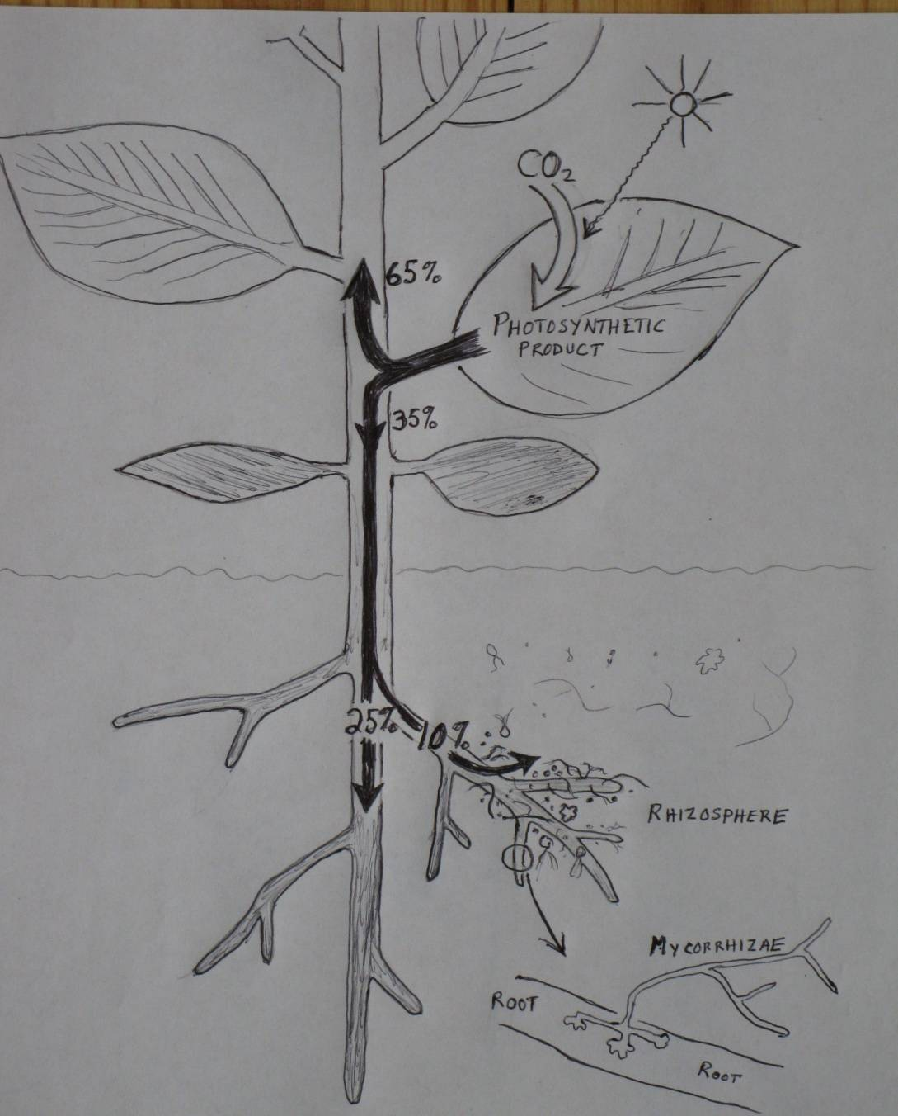
Plant Roots Play a Vital Role in the Soil Food Web
Root exudates and fine roots
Rhizosphere
Mycorrhizal fungi

Slide 6
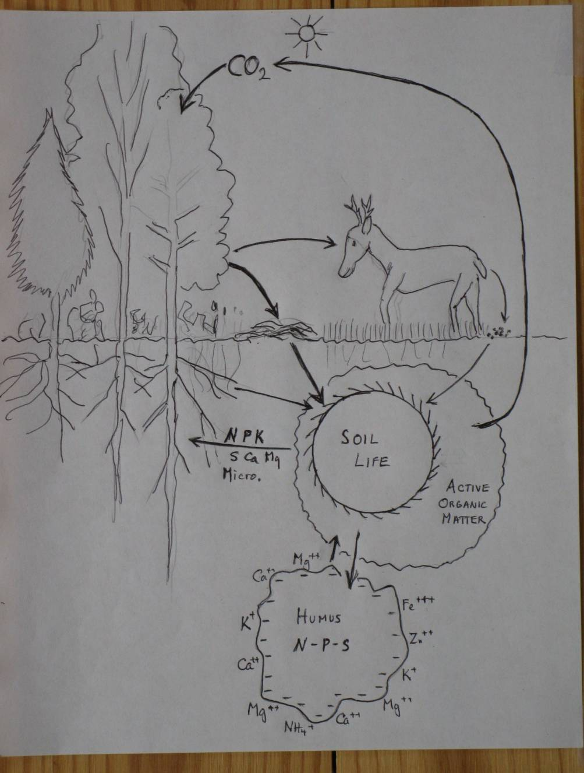
The Organic Matter Cycle
The soil food web is the engine of soil fertility.

Slide 7
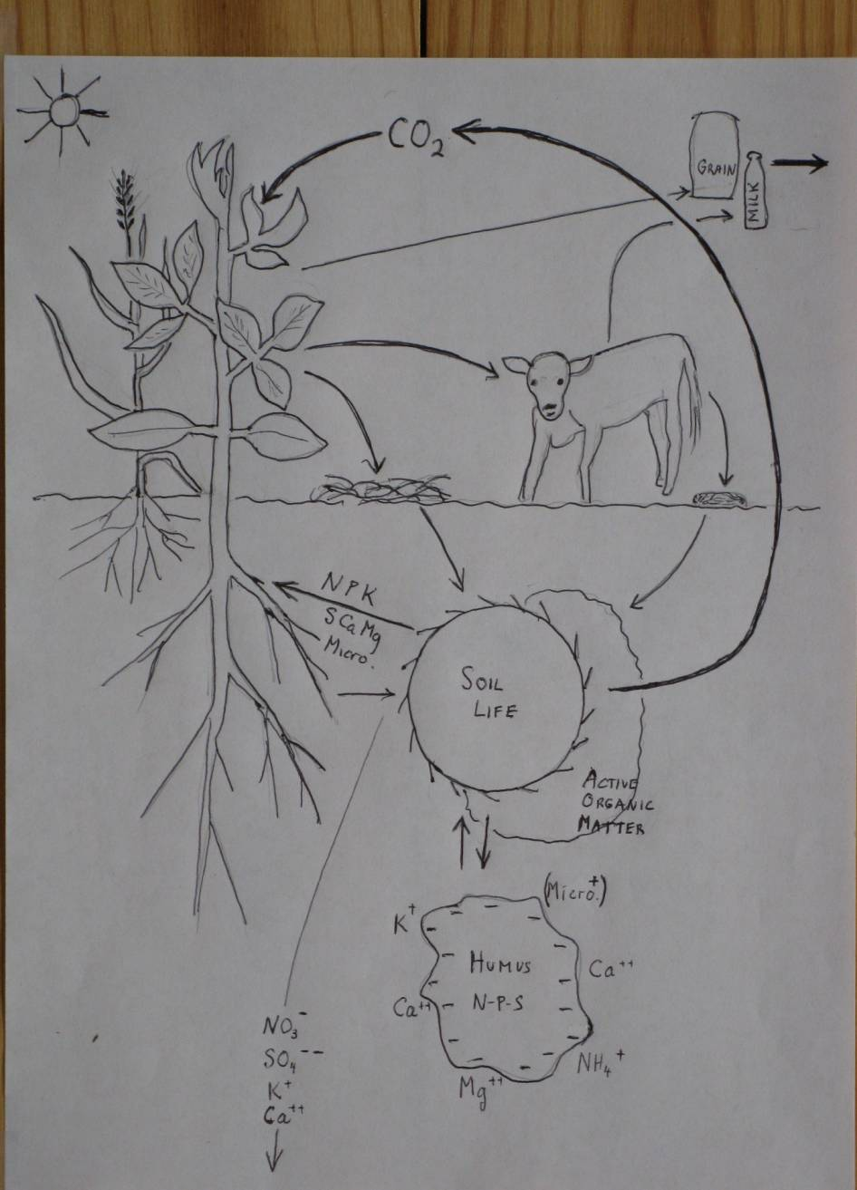
The Organic Matter Cycle in Agriculture
Harvest removes organic matter and nutrients.
Tillage hastens organic matter decomposition and nutrient leaching.

Slide 8
Replenishing the Organic Matter Cycle
Organic farmers feed the soil life a diverse “balanced diet” of:
Cover crops and green manures
Compost
Organic mulches
Crop residues
Manure
Organic fertilizers and amendments

Slide 9
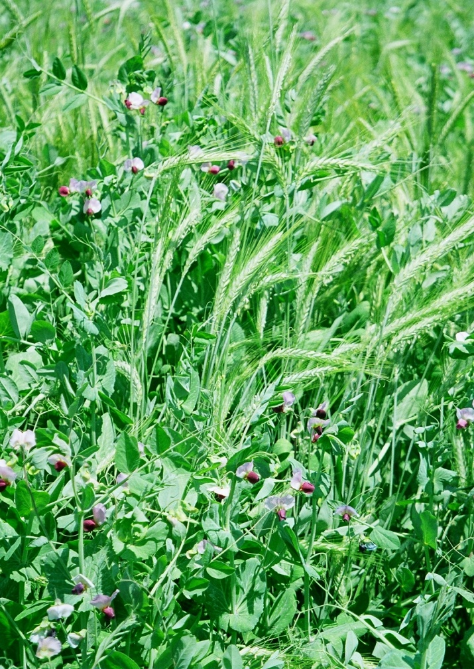
Cover Crops: the Cornerstone of Sustainable Crop Production
Cover crops:
Prevent soil erosion, compaction, crusting
Add organic matter
Feed the soil life
Fix N (legumes)
Improve P and K availability
Triticale + Field Pea

Slide 10
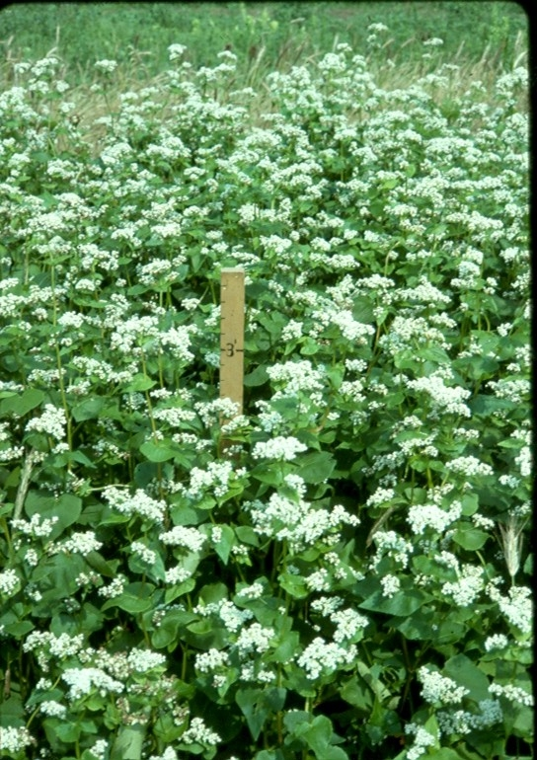
Cover Crops: the Cornerstone of Sustainable Crop Production
Cover crops reduce pest problems by:
Suppressing weeds
Breaking pest and disease life cycles
Providing habitat for beneficial organisms
Buckwheat

Slide 11
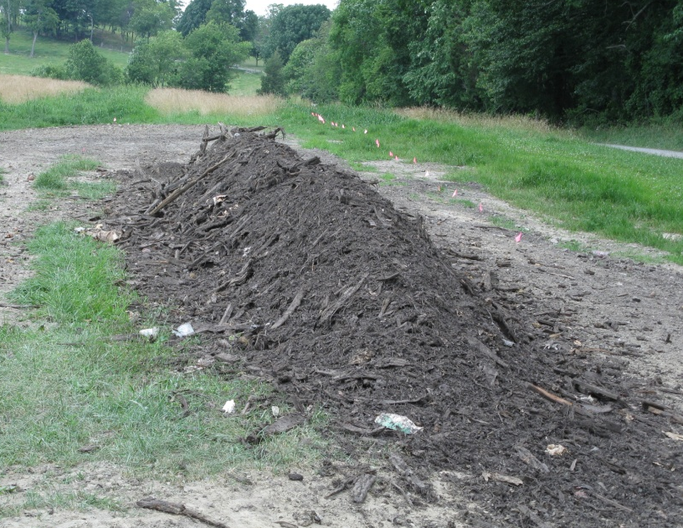
Compost: the Hallmark of Organic Farming
The composting process is an intensified organic matter cycle achieved by combining organic residues in a pile or windrow, and managing temperature, aeration, and moisture.
Mixture of food waste, tree
leaves, and chipped brush
undergoes hot composting.

Slide 12
Compost:
Temperature – 131–170°F for 15 days
Turned 5 times to keep aerobic and heat all portions
Balanced C:N ratio – 25:1–35:1 in starting mix
Optimum moisture content 50–60%

Slide 13
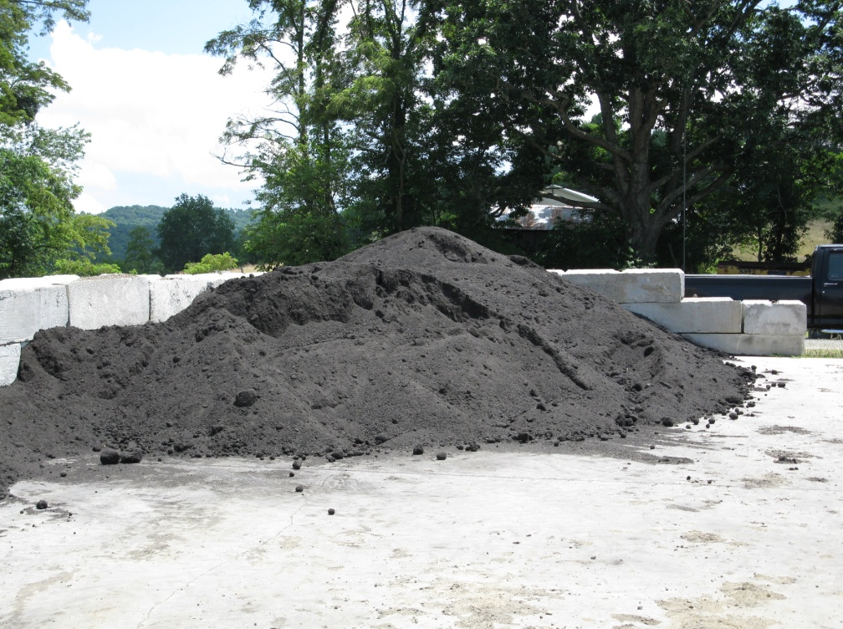
Good, finished compost provides:
Beneficial soil organisms
Active organic matter
Stable humus
Slow-release nutrients
Nutrient and moisture holding capacity
Fig: High quality finished compost.

Slide 14
Manure: the Original Organic Fertilizer
Manure benefits:
N, P, K, and micronutrients
Ingredient for composting
Supports beneficial soil life
Manure cautions:
Unstable N
Weed seeds
Salts
Unbalanced N:P ratio
Cu and Zn excess (poultry litter)
Pathogens

Slide 15
Manure Management
Know the source, avoid chemical residues.
Compost or age with carbon (e.g., bedding) to stabilize nutrients.
Spread on heavy feeding cover crop.
Adjust rates to optimize soil P, K, and micronutrients.

Slide 16
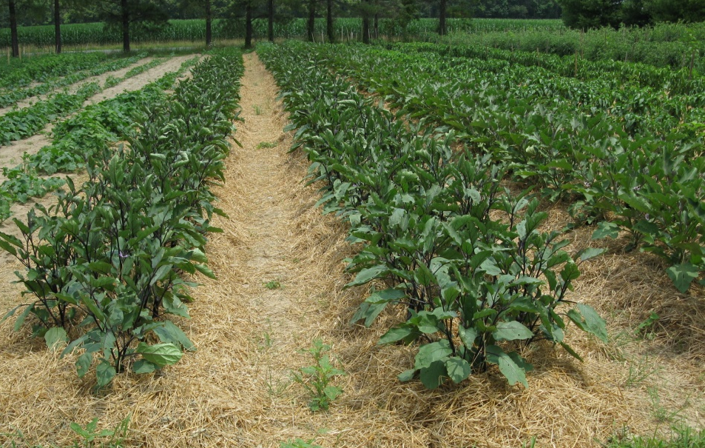
Organic Mulch: Simulating Nature’s Way of Feeding the Soil
Organic mulches:
Protect the soil surface.
Conserve soil moisture.
Suppress annual weeds.
Feed the soil life.
Provide slow-release nutrients.
Provide beneficial habitat.
Eggplant thriving and nearly
weed-free in straw mulch.

Slide 17
Mulching cautions:
Weed seeds
Herbicide residues
Cooler soil
Potential pest habitat
Excess K (grass hay)
Costs of purchase, hauling, and spreading

Slide 18
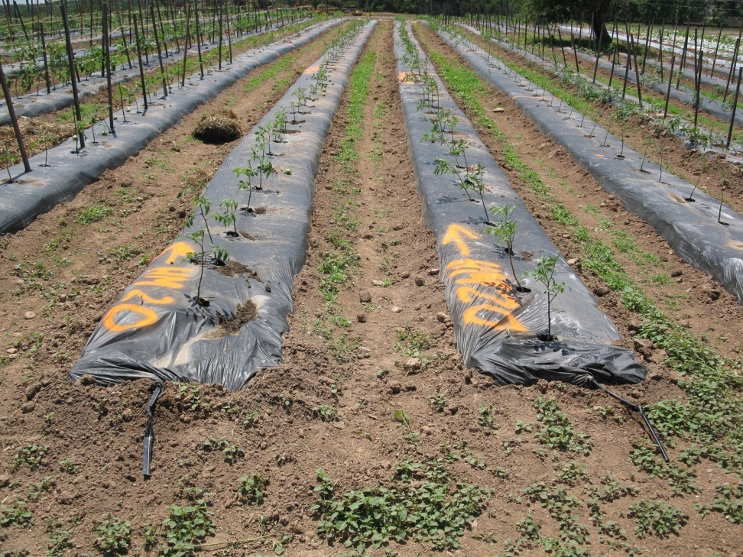
Plastic Mulch
Excellent weed control within crop beds
Warms soil
Practical at farm scale
However:
Does not “feed” soil
Must be removed at end of season
Alleys prone to erosion and weeds
Black plastic film warms soil
and suppresses weeds near
crops. Alley weeds must
be controlled by other means.

Slide 19
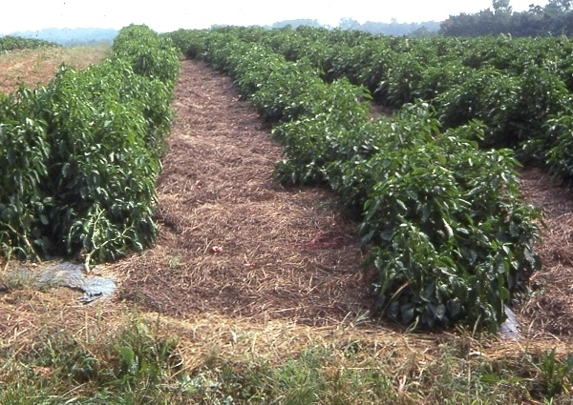
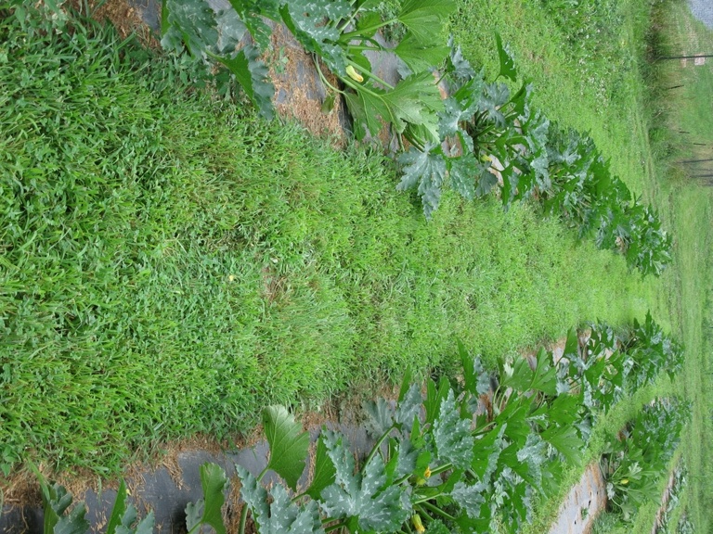
Adding Organic Matter while Using Plastic
Covering alleys with organic
mulch (above) or a rye + clover
cover crop (right) protects soil in
alleys and adds organic matter.

Slide 20
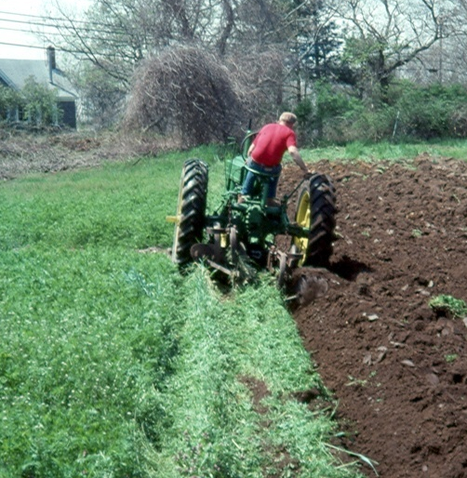
Tillage: The Organic Farmer’s Dilemma
Tillage is done to:
Incorporate residues.
Prepare a seedbed.
Manage / remove weeds.
Tillage also:
Burns up organic matter.
Compromises soil quality.
Contributes to erosion.
Stimulates weed germination.
Plowing down a hairy
vetch green manure.

Slide 21
Judicious tillage
To get the most benefit with the least harm:
Know the objective – till only when warranted.
Select the best tool for the job.
Till when soil moisture is optimal.
Plant promptly – avoid prolonged bare soil.
Recent studies show that organic systems with careful tillage can sequester as much soil carbon as conventional no till.

Slide 22
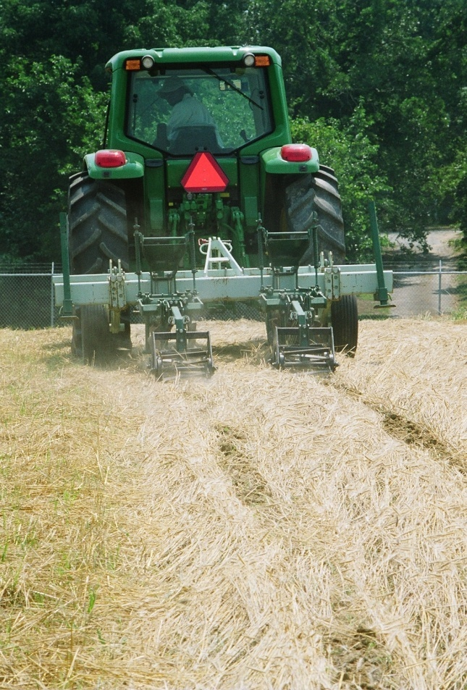
Conservation Tillage in Organic Agriculture
Mulch tillage (residue left on surface)
Ridge tillage
Strip or zone tillage
Organic no-till into roll-crimped or mowed cover
Deep till (break hardpan, promote deep rooting)
Strip tillage through
wheat residues

Slide 23
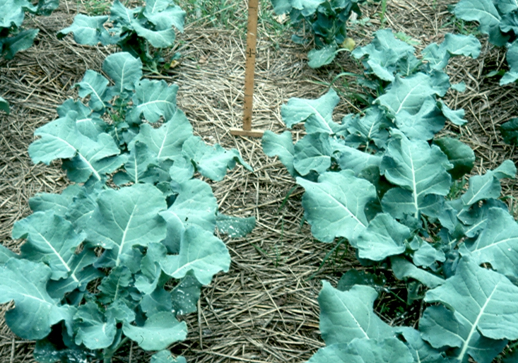
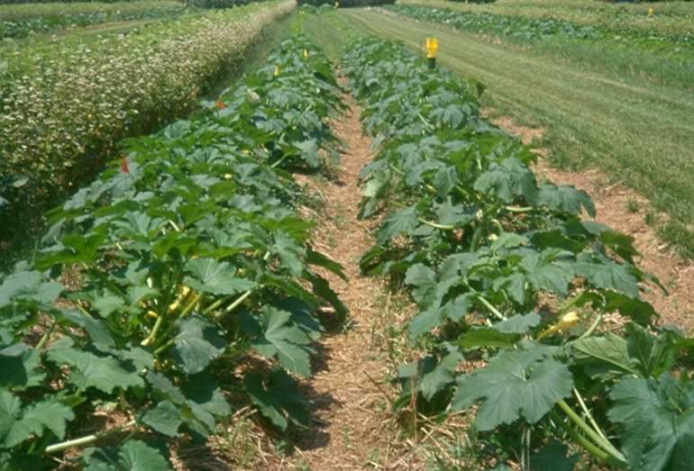
Organic No-till Examples
Summer squash in roll-crimped rye + hairy vetch.
Broccoli in mowed rye + hairy vetch

Slide 24
Can “Feed the Soil” adequately feed a vegetable crop?
In high quality soil, the soil food web provides for most of the crop’s nutrient needs.
In practice, some supplemental nutrients are usually needed for optimal production.
Must replenish organic matter and nutrients consumed in production.

Slide 25
Understanding and Treating Possible Causes of Crop Nutrient Deficiency:
One or more nutrients are scarce in the soil
Add appropriate amendments
Soil life is depleted or unbalanced
Apply good compost to replenish soil life, and supply “food” (cover crops, residues, etc)
Soil compaction or hardpan restricts roots
Chisel or subsoil, plant deep-rooted crop
All of the above factors may be present

Slide 26
Organic and natural mineral fertilizers are applied to:
Restore depleted soils
Address specific nutrient deficiencies
Adjust soil pH
Meet nutrient demand of heavy feeders
Replenish nutrients removed in harvest

Slide 27
How to Translate Soil Test Recommendations to “Organic”
Consider:
Nutrient removal by harvest
Soil physical and biological condition
Potential nutrient release by soil life
Slower release from organic amendments
Environmental impacts of inputs

Slide 28
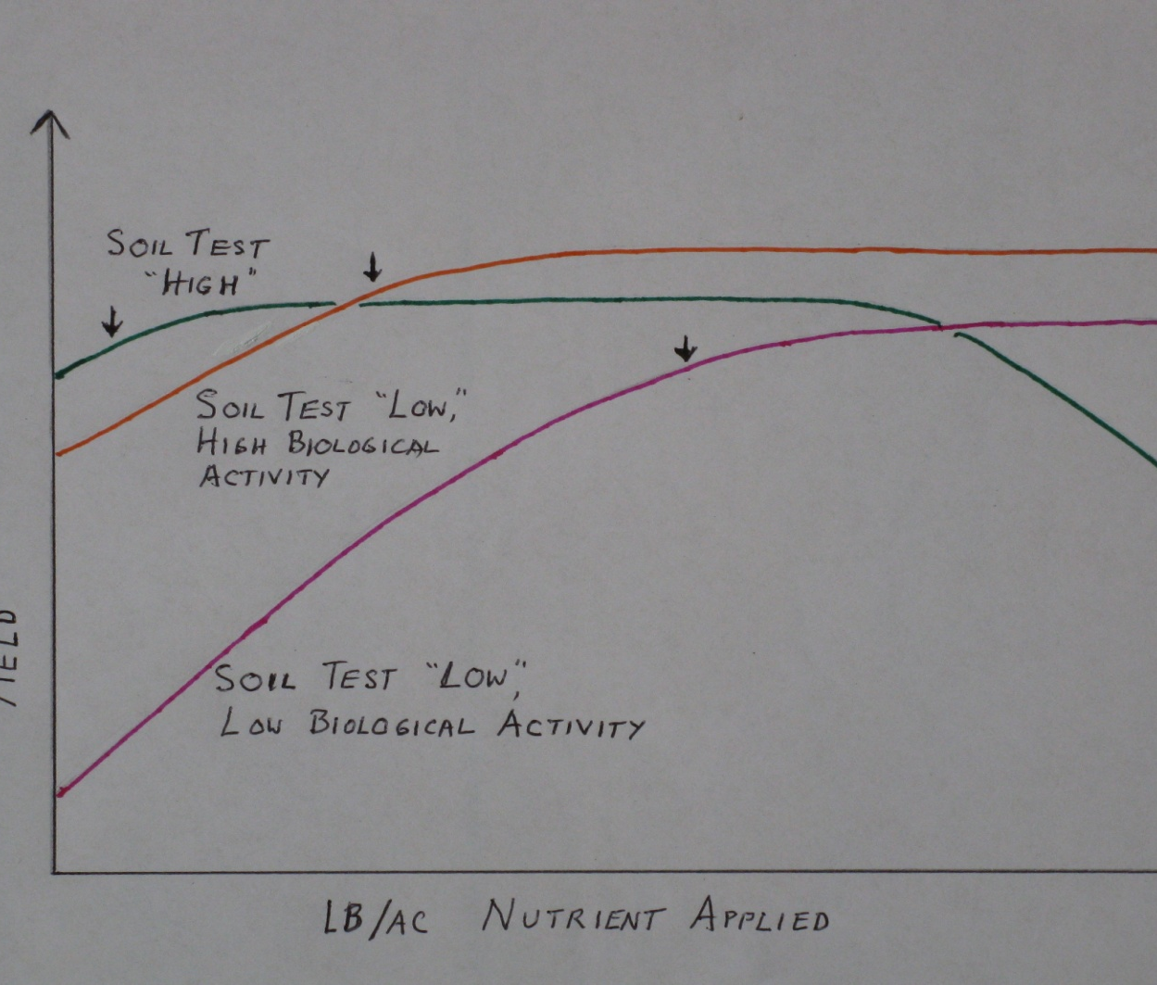
Research-based Nutrient Recommendations
↓= most profitable application rates.

Slide 29
Tips on Using a Soil Test in Organic Nutrient Management
Correct sampling procedure is important.
Note deficiencies, excesses, and imbalances.
Observe the soil and crops.
Verify with plant tissue analysis.
Re-test with same lab to monitor trends.

Slide 30
Soil pH and Lime
Most vegetables prefer pH 6.0-7.0.
Blueberries prefer pH 4.8-5.2.
Use high-calcium limestone if Mg is high.
Use dolomitic limestone if Mg is low.
Use elemental sulfur to lower pH.
Hydrated lime and quicklime are prohibited.

Slide 31
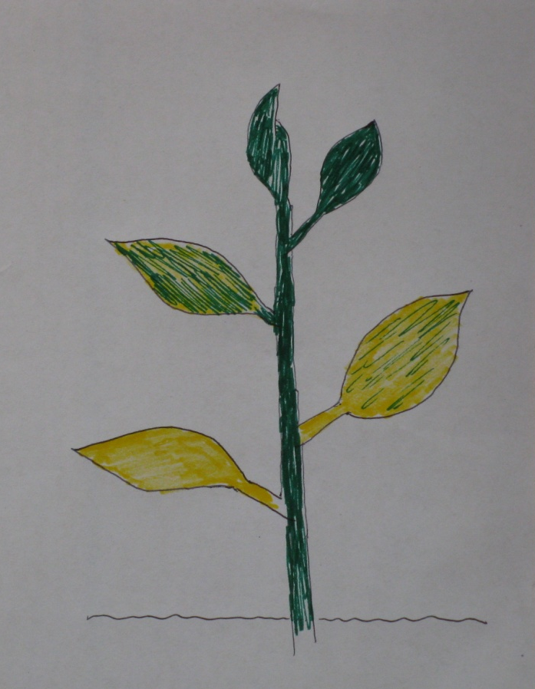
Nitrogen (N)
Plants utilize soluble mineral forms of N
Most soil N is in organic matter.
Soil life mediates N availability and storage.
Legumes are important N source.
Deficiency: older leaves turn yellow.

Slide 32
Carbon-to-nitrogen (C:N) Ratio and soil N dynamics
Soil life utilizes 25-30 lb C for every lb N.
Organic residues with C:N > 30:1 tie up N.
Organic residues with C:N < 25:1 release N.
Biological processes reduce C:N of materials.

Slide 33
Sources of N
For Organic Agriculture:
Feather meal
Blood meal
Fish meal
Legume cover crops
Conventional:
Urea

Slide 34
Nitrogen Budgeting in Organic Farming
Estimating N available to the current crop:
Estimated N from mineralization by soil life
Legume cover crops (~50% of total N)
Manure (~50% of total N)
Compost (10-25 % of total N)
Organic N fertilizers if needed

Slide 35
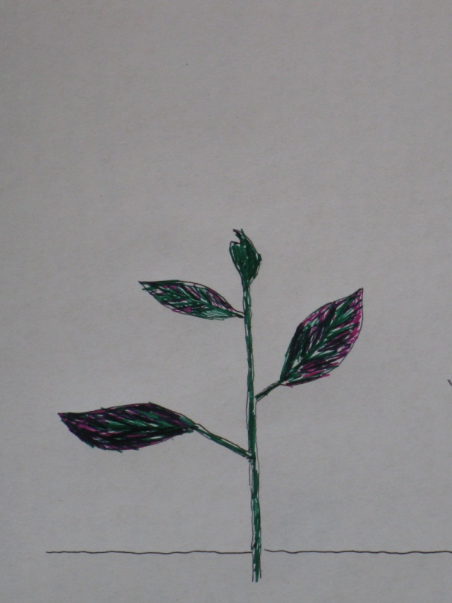
Phosphorus (P)
Plants use soluble phosphates.
Most soil P exists in insoluble mineral and organic forms.
Soil life can enhance P availability.
Mycorrhizae play vital role in P nutrition of many plants.
P surplus accumulates in soil.
Deficiency: stunted
growth, purple or
reddish leaves

Slide 36
Sources of P
In Organic Farming:
Rock phosphate
Colloidal phosphate, calphos
Bone meal
Conventional:
Triple superphosphate

Slide 37
Nitrogen-phosphorus balance
Plants utilize N and P in a ratio of 6:1 – 10:1.
Manure and compost provide N and P at about 3:1.
Some manure N is lost, P is mostly stable.
Using manure or compost for N can build up P.
Legume cover crops add N but not P.

Slide 38

Potassium (K)
Plant-available K is mostly held on clay and humus.
Most soils have large insoluble mineral K reserves.
Vegetables use a lot of K.
K surpluses build up in most soils, leach from sandy soils.
Deficiency: white spots,
singed or tattered
edges on older leaves

Slide 39
Sources of K
In Organic Agriculture:
Potassium sulfate
Sul-po-mag
Greensand (7% K but mineral-fixed)
Grass hay mulches (up to 2% available K₂O)
Conventional:
Potassium chloride

Slide 40
Potassium and Nutrient Balance
Hay or grass mulches are very rich in K.
Composted or aged manure may add more K than N.
Excess K can interfere with Mg or Ca nutrition:
Blossom end rot, tip burn in vegetables
Grass tetany in livestock

Slide 41
Other Essential Plant Nutrients
Calcium
Magnesium
Sulfur
Iron
Manganese
Boron
Zinc
Copper
Molybdenum
Nickel

