Slide 1
Advance Organic Agriculture Lecture 9
Ananta Prakash Subedi
M.Sc. Ag. (Conservation Ecology)

Slide 2
Lecture includes:
Seasonal Extension of Organic crop
Integrated Pest Management
Biological Control

Slide 3
Seasonal Extension

Slide 4
Definition
Seasonal extension refers to any practice that allows a crop to be cultivated or harvested outside its normal production season. Growers may be able to capture a greater market share by being able to provide product to distributors and retail outlets when their competitors cannot.

Slide 5
Two primary goals
To protect crops from frost or head damage
Speed the growth of crops for quicker maturity and higher quality

Slide 6
Farmers through the centuries have learned to use available materials to produce earlier crops in the spring, grow cool-season crops in summer, maintain production well into the fall, and even harvest crops through the winter.
Different methods like cold frames heated with manure, shade structures, wind breaks, irrigation, masonry walls or stone mulch as heat sinks, and cloches (glass bell jars) to protect individual plants.

Slide 7
Examples of Seasonal Extension Techniques
Raised beds:
Soil has been loosened and piled up to a level above that of the surrounding soil surface. Raised beds heat up more quickly in spring, allowing earlier planting.
Mulches:
Plastic mulches are used to suppress weed growth, retain soil moisture, increase soil temperatures, and speed crop growth. Organic mulches are typically applied to retain soil moisture, increase soil organic matter content and cool soils.

Slide 8
Row covers:
Light, porous, permeable fabrics placed over plants in order to retain heat, useful for frost protection as well as protection from wind and insect pests.
Cold frames:
Transparent roofed enclosures built low to the ground used to protect plants from cold weather. Mostly used in home gardens to grow seedlings that are later transplanted into the field.

Slide 9
Fully heated and artificially lit green house:
Ultimate season extension device allows crops to be grown year round, even through sub-zero winters. The adoption of this energy intensive form of season extension by organic farmers has been debated in the organic and sustainable agriculture communities.
Irrigation and Wind machine:
Irrigation is applied to crops to prevent damage due to high or low temperatures, and wind machine to prevent accumulation of cold air near the ground, protecting blossoms and crops from cold damage.

Slide 10
Advantages of Season Extension
Higher productivity and income
Higher prices at times of the year when other local growers do not have produce
Extended or year round employment for skilled employees
Higher yields
Better quality

Slide 11
Disadvantages:
No break in the work schedule
Increased management demands
Higher production costs
Plastic disposal problems
Increased risk of crop failure if strategies are unsuccessful.

Slide 12
Integrated Pest Management

Slide 13
Introduction
In organic agriculture, all preventive measures to support plant health and productivity should be exploited first, before implementation of direct control measures. Since the occurrence of diseases depends on many factors (e.g. cultivar susceptibility, pedoclimatic or general weather conditions, etc.), the risk and virulence of diseases may vary in different environmental conditions and cropping systems.
Organic farmers face the same potentially severe pest problems as their colleagues in integrated pest management (IPM) and conventional crop farming. However, approaches to manage insect pests are different. In organic cropping systems farmers are supposed to apply preventive measures to keep pests abundance under damaging levels, thus minimizing the need for direct and curative pest control.
.

Slide 14
Concept of plant health in organic agriculture
The figure above illustrates the importance of the holistic approach in organic farming. We should take in consideration that not every farm can implement the entire know-how of disease and pest prevention. Sometimes, lowering a risk may enhance the risk for another disease and pest to arise. Eventually, certain weather conditions, the development of resistance, and other factors may lead to disease and pest outbreaks even when all possible preventive measures have been taken into account.

Slide 15
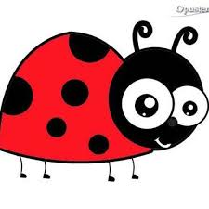
Resilience of cropping systems
Increasing the resilience of a cropping system involves the increase in the ecosystem diversity through the establishment of non-crop habitats and biotope networks.
Secondly, farmers can reduce damages by rotating crops, increasing crop diversity, planting at the right time, harvesting, transplanting, weed management, choice of resistant varieties, and by avoiding growing areas with high pest and diseases pressure.
The combination of all these measures creates a broad and solid basis for healthy plant development, while direct control measures can be applied in case of threatening pest and diseases outbreaks.

Slide 16
Disease control
Through preventive measures
Prevention is a key strategy for organic producers, since diseases can rapidly spread and their control can be difficult if farmers only resort to organic pesticides.
For several crops and diseases, the risk of infections by plant pathogens can be lowered by the use of less pathogen-susceptible, tolerant and resistant varieties. However, resistant varieties are not available for all diseases.
Seeds infested with pathogens are a major source of disease outbreaks in many arable crops. This can be avoided by the use of certified seeds. When seeds are produced on farm, they should be inspected and, if infested, they need to be treated by appropriate methods such as heat or PPPs suitable for organic farming.

Slide 17
3.2 Cultural measures
The implementation of optimal crop rotations is another important measure to reduce the risk of disease build-up. In cases of pathogens that can survive for several years in the soil, rotation breaks of several years for the same crop are necessary.
Tillage, such as deep ploughing after harvest, is a general measure to reduce inoculum for the next season. However, tillage choice will be influenced by soil type and trade-offs with soil organic matter storage, greenhouse gas emissions and weed management. We should also keep in mind that deep ploughing is in conflict with soil conservation and such aspects need to be considered as well.

Slide 18
What is IPM?
Integrated Pest Management is a sustainable approach to controlling insect pest populations that combines PAMS
Prevention
Avoidance
Monitoring
Suppression
Combination of strategies that minimizes economic, health, and environmental risks.

Slide 19
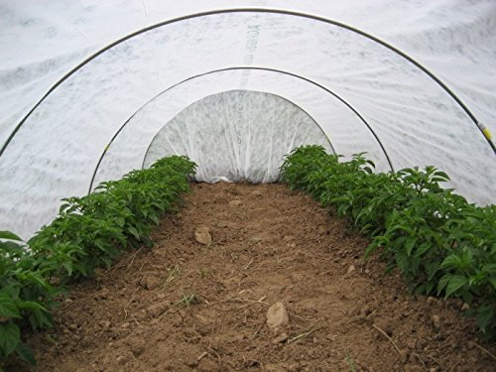
Prevention
Various practices that keep pests from infesting a production site (i.e. field, orchard, or greenhouse)
Examples
Using pest free seed or transplants
Field sanitation
Eliminating alternative hosts

Slide 20
Avoidance
When pests are already present in the general area, but pest impact can be minimized through various cultural practices.
Crop rotation
Crop choices
Trap crops
Adjusting planting schedule
Early planting, late planting, not planting
Resistance traits
Fast maturing varieties

Slide 21
Monitoring
The key component to any IPM program
Proper identification of pest – know your enemy
Monitoring program
Traps
Weather monitoring
Soil testing, when appropriate
Record keeping
Pest incidence and distribution in each field

Slide 22
Suppression To avoid economic loss, population suppression technique may be necessary
Cultural practices
No-till or strip till
Cover crops or mulches
Companion planting
Physical suppression
Baited or pheromone traps
Exclusion devices
Row covers
Biological Control
Mating disruption
Pheromone
Sterile release
Conservation
Augmentation
Chemical/biopesticide control
Considered a last resort
Evaluate Cost to benefit ratio

Slide 23
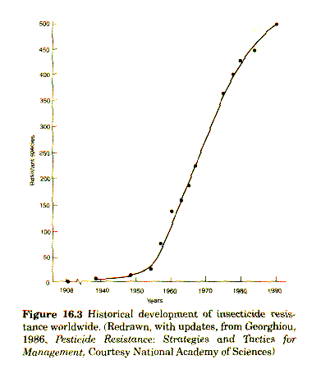
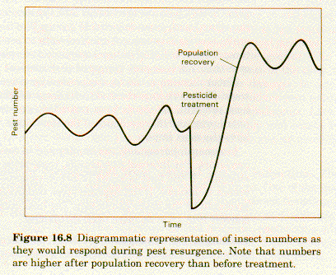
What does Resurgence and Resistance look like?
Notes:
The above charts show pest resurgence and pest resistance . You can read more about these in ATTRA’s publication on Biointensive Integrated Pest Management.

Slide 24
The Basic Elements of an IPM Program
Understand the biology and economics of the crop or resource.
• Identify the key pests and learn their biology and life cycle.
• Consider using combinations of methods and materials to manage pests.
• Direct control practices at the weak link in the life cycle of key pests.
Monitor fields regularly and systematically
• Use control methods that preserve and enhance naturally occurring beneficial organisms.
Know crop growth cycle
Know the pest
Combine methods
Attack the weak link
Monitor
Preserve beneficials

Slide 25
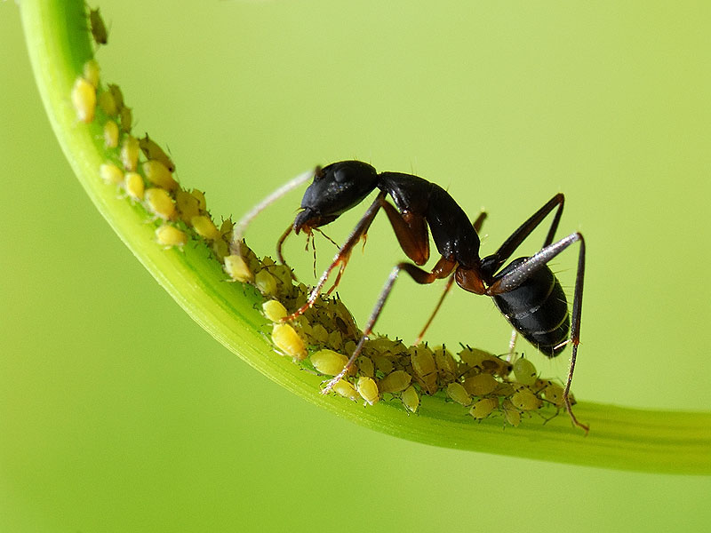
Planning an on Farm IPM Program
Ecosystem management
Cultural control
Information resources
Monitoring program
Record keeping
An economic threshold- the insect's population level or extent of crop damage at which the value of the crop destroyed exceeds the cost of controlling the pest.

Slide 26
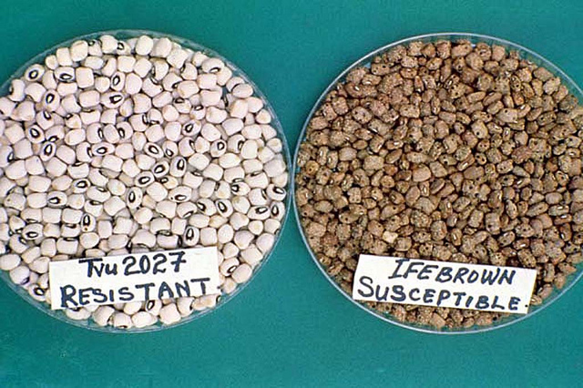
Cultural Control
Varieties/Cropping System
Developmental rate
Planting dates/harvesting dates
Crop rotation

Slide 27
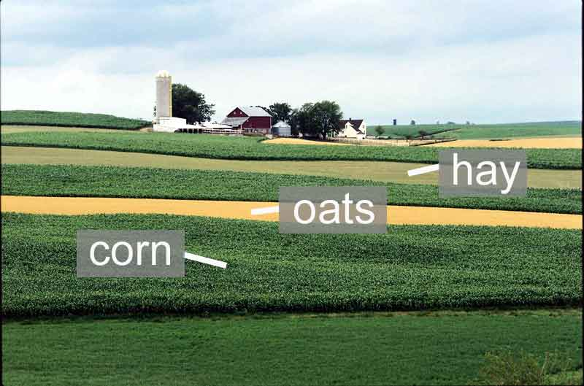
Cropping Systems
Control achieved through various planting methods:
Multiple cropping
Sequential production
Interplanting
Cover crop
Intercropping
Two or more crops on the same land at the same time
Strip cropping

Slide 28
Biological Controls
Conservation of naturally occurring methods of population stabilization
Predators
Parasitoids
Augmentation of organisms that will help to stabilize population of pests
Predators
Parasitoids

Slide 29
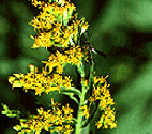
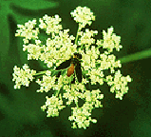
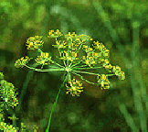
Plants to Attract and Feed Beneficial Insects
goldenrod
Umbelliferae family
carrot, yarrow, Queen Anne’s lace, dill, anise, fennel, coriander, parsley
Compositae family
zinnia, marigold, aster, daisies, mums, black-eyed susan, coneflower, Coreopsis
Mint family and Perennial herbs
mints, thyme, sage, oregano, bee balm, basil
Other plants
salvias, wallflowers, nasturtiums, poppies, etc.
wild carrot
dill
Farmscaping is the concept of “the creation of habitat to enhance the chances for survival and reproduction of beneficial organisms as applied to a farm operation.”
Many of the beneficial insects are small insects that feed on small flowers like those on plants of the carrot and mint families.

Slide 30
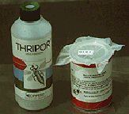
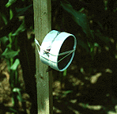
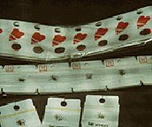
Augmentation: Predator/Parasite release

Slide 31
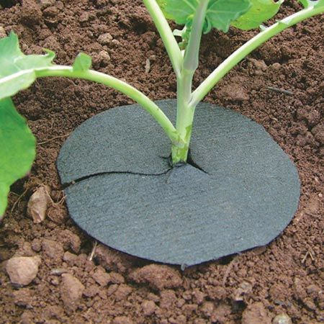
Mechanical/Physical controls
Row covers
Hand picking
Sticky boards
Plant collars

Slide 32
Insecticides
Chemical pesticides
Biochemicals
Synthetic pesticides with properties of natural substance
Biopesticides
Bacteria
Fungi
Viruses
Many implications for use in organic systems

Slide 33
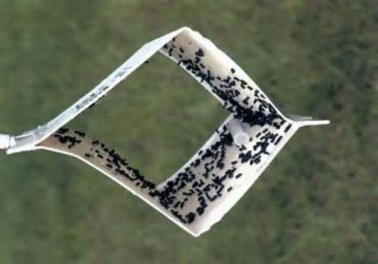
Monitoring of pest populations
Random Samples: a measure of the total population
Scouting fields
Hand lens
Random samples
Trapping
Pheromone traps
Light traps
Pit fall traps
Sticky traps
Sweep Net
Vacuuming
Beat sheets
Notes:
Various methods of scouting and monitoring pest and benficial insect populations.

Slide 34

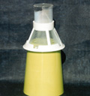
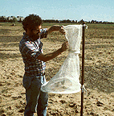
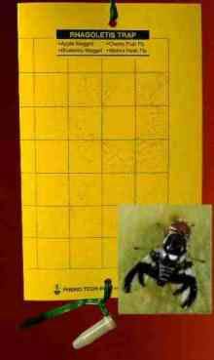
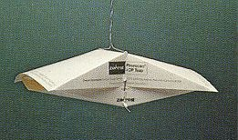
Trapping
Visual trap
Lure trap
Pheromone trap
Pheromone trap
Visual trap

Slide 35
Pests and Beneficials
Pair up and review the information sheet on the selected pest or beneficial insect. Present back to the group:
If a Pest:
What is the life cycle of the insect?
What plants does it typically impact?
What are some management and control methods
If a beneficial:
What is the life cycle of the insect?
What plants or other insects does it typically impact?
What are some methods for attracting or propagating the beneficials?

Slide 36
Biological Control

Slide 37


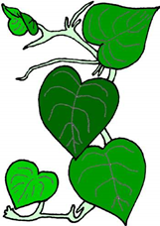






How weed biological control works
Exotic plants often reach much higher densities when they are moved to new geographic areas. This is because the plants escape control by natural enemies that occur in their native range. Natural enemies typically include insects and disease causing pathogens. Some natural enemies are highly host specific, meaning that they will only feed or infect one or a very few plant species. Biological control involves the identification of these specialized natural enemies and their introduction into the invaded range. If successful, the natural enemies provide a self-sustaining and permanent suppression of the target weed.
Invaded area
Native home
Biological control
Click

Slide 38
Biological Control of Insect Pests
Conservation biological control:
Provide nectar and pollen for existing allies.
Provide overwinter habitat sites.
Protect habitat from pesticides and tillage.

Slide 39
Purchased Biological Controls
Use when cultural and indigenous biological controls fail.
Provide suitable habitat.
Time release for maximum efficacy.
Examples:
Pedio wasp for bean beetle
Lady beetles or lacewings for aphids, whiteflies
Trichogramma wasps for caterpillar pests

Slide 40
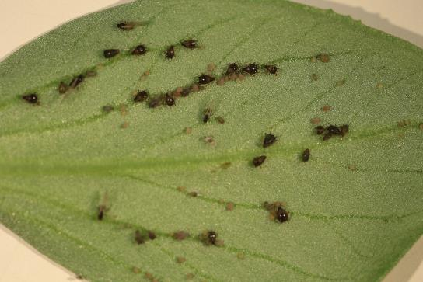
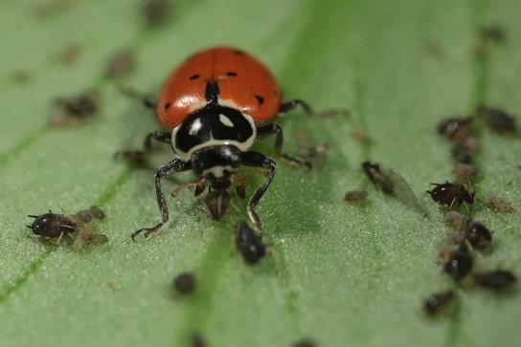
What is biological control?
Pest
Beneficial

Slide 41
What is biological control ?
Explain pest, natural, enemy. A pest is an organism that is in a place that we don’t want it to be. That doesn’t mean that it isn’t supposed to be there, just that it is somehow interfering with human activity. Pests of plants include many common things such as aphids and caterpillars but also less seen things such as mites and nematods. All of them somehow feed off the plant, which can reduce plant quality and output. If your fava bean has an aphid infestation above a certain level it will produce fewer beans. But just as the aphids are eating the plant, there are things that eat the aphids and other pests. These are called natural enemies. In a chemical free environment they provide a defense of the plants that people want to use. This process is called biological control.

Slide 42
Biological control
What it is… “3 sets of 3”
Who? – Predators, Parasites (Parasitoids), Pathogens
To do what? – To reduce, delay, or prevent insect infestations
How? – By conservation, augmentation, or importation of natural enemies

Slide 43
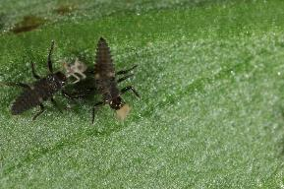

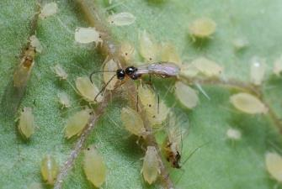
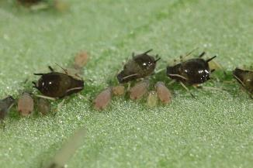
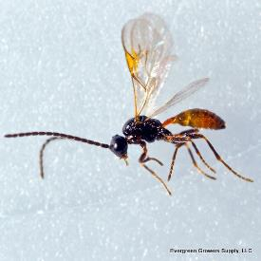
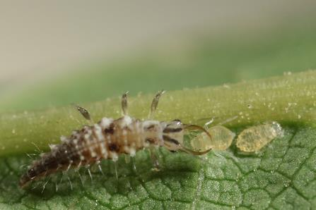
More than one natural enemy is often better

Slide 44
Complementarity. They use the aphids differently, maybe different stages or areas so that overall more aphids are eaten

Slide 45
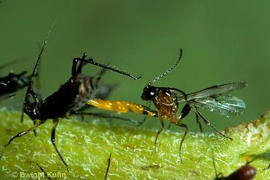
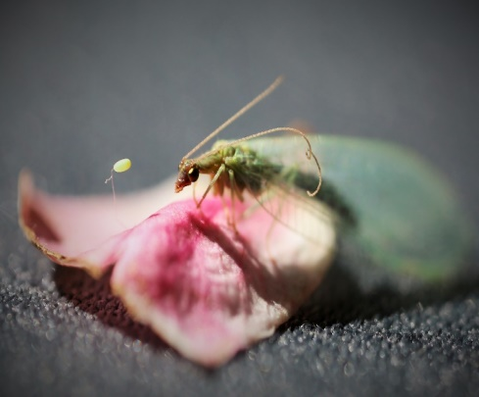
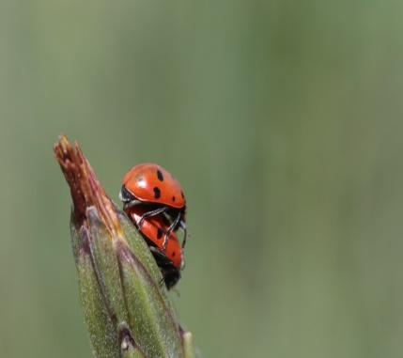
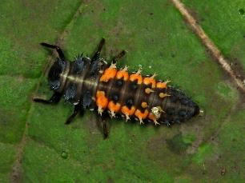
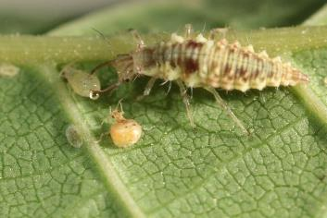
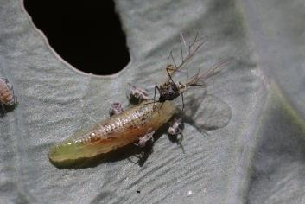
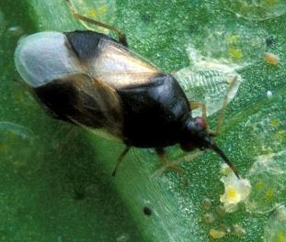
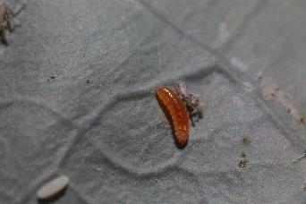
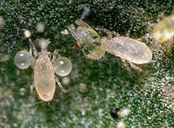
There are many different kinds of natural enemies

Slide 46
Biological control in commercial farms
Biological control helps farmers control pests on many crops. Sometimes farmers actively encourage biological control, sometimes it just happens. When lots of broad spectrum insecticides are used it is harder to use biological control because the insecticides also kill the beneficial insects.

Slide 47
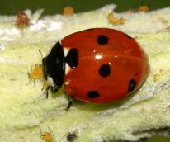
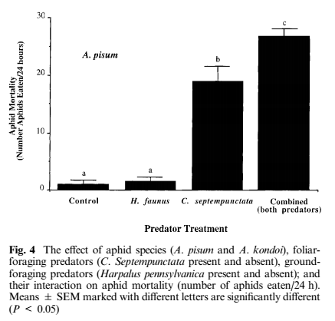

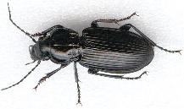



Alfalfa aphid predators
Combined effect greater than individual effects added together
Losey, J. E. and R. F. Denno. 1998.
Example of two better than one

Slide 48
Biological control in our garden!
Many many home and college gardens benefit from biological control. Once we know what you are looking for, we will see natural enemies everywhere! In order to get on our way, we’ll go over some pictures of the most common and visible natural enemies.

Slide 49

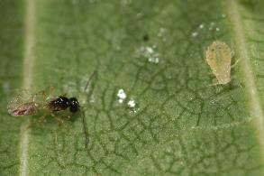
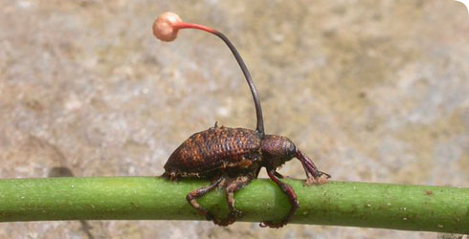
Types of natural enemies
Predator
Parasitoid
Pathogen
Although pathogen can be common, the are harder to ID. But predators and parasitoids are visible and useful for us in our garden!

Slide 50
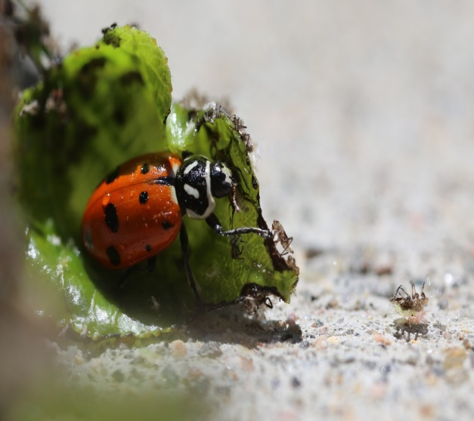

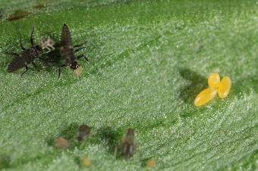
Lady beetles (predator)
Common predator. Here are pictures of the eggs, juveniles, and an adult.

Slide 51


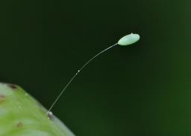
Lacewings (predator)
Common predator. Here are pictures of the eggs, juveniles, and an adult.

Slide 52
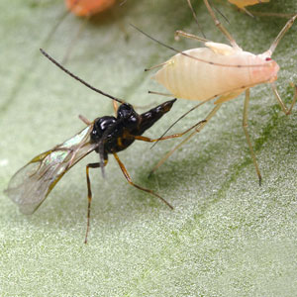
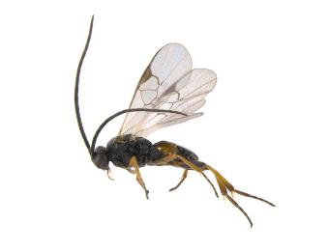
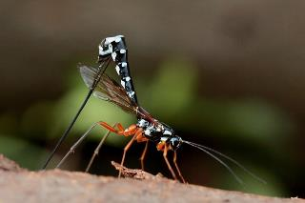
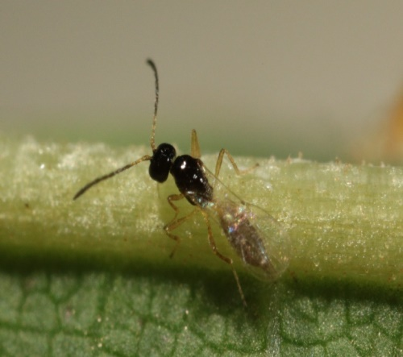
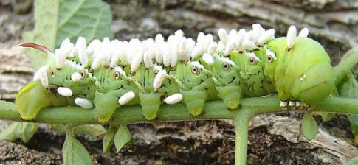
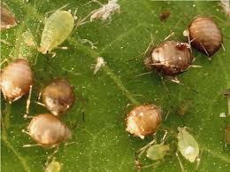
Parasitoids
Parasitoids lay their eggs inside other insects. The juveniles then consume the insect and emerge as adults.

Slide 53
Biological control: To do what?
Reduction ... natural enemies are introduced after the pest is established. Examples: Vedalia beetle and cottony cushion scale, predators and parasites of alfalfa weevil, cereal leaf beetle, gypsy moth, countless others.
Delay (pest buildup) ... early intervention after initial detection of a pest.
Prevention ... releases of natural enemies are made early in the season, against a predictable pest; rarely done.

Slide 54


How to promote natural enemies
The sunflower family (includes daisys) and the parsley family (includes yarrow and other umbrella shaped flowers) are good for attracting natural enemies. Having perennial flowering plants or leaving plants to bolt and flower both support natural enemies.

Slide 55

Habitat and variety
Having a variety of habitats in your gardens gives the natural enemies places to shelter

Slide 56
Biological control: How?
Conservation ... nearest to natural control (but conscious and planned); may involve enhancing benefits (using attractants or foods to keep predators and parasites in an area); often involves altered production practices or pesticide application plans.
Augmentation ... adding natural enemies; works if the practice adds to overall mortality instead of replacing existing mortality factors. Involves buying or rearing natural enemies.
Importation ("classical biological control") ... Many pests are exotic; they were introduced without their natural enemies; importing natural enemies "reunites" the pest with its natural control agents. Importation must involve extensive natural history studies and a quarantine stage to avoid unwanted outcomes.

Slide 57
Pathogens:
Bacteria
Viruses
Fungi
Protozoa (microsporidia)
Nematodes

Slide 58
Pathogens:
Many are important in causing population crashes in nature (natural biotic control, not biocontrol), especially...
viruses in Heliothis / Helicoverpa (tobacco budworm and corn earworm), alfalfa looper, tent caterpillars and forest sawflies;
fungi in alfalfa weevil, potato leafhopper, and green cloverworm;
microsporidia in grasshoppers, corn borer, many others (not complete population crashes, just markedly "poor performance")
See handout for more details. Though some have been mass‑produced and packaged, for the most part, these have not been readily formulated as effective "microbial insecticides".

Slide 59
Pathogens: Viruses
Viruses commonly cause disease outbreaks and population crashes in caterpillars. A few virus‑based biopesticides are available commercially, but they are not used widely. (Products include viruses that infect codling moth, gypsy moth, corn earworm, tussock moth, and others.)

Slide 60

Pathogens: Bacteria
Bacillus thuringiensis: rarely responsible for obvious natural control, but effective as a microbial insecticide ...
B.t. kurstaki and B.t. aizawai ‑‑ kill caterpillars (Dipel, Agree, XenTari)
B.t. israelensis ‑‑ kills larvae of several mosquitoes, black flies, fungus gnats (Altosid, Vectobac, Gnatrol)
B.t. tenebrionis ‑‑ kills larvae of Colorado potato beetle, elm leaf beetle, a few others (M‑One, M‑Trak, Foil)

Slide 61



Pathogens: Bacteria
B. sphaericus ‑‑ Larvae of some mosquitoes (no commercial formulations at present)
B. popilliae & B. lentimorbus ‑‑ kill larvae of Japanese beetle, not as effective against other white grubs (Doom, Japidemic)

Slide 62
Pathogens: Insect-pathogenic fungi
Insect‑pathogenic fungi often cause disease outbreaks in insect populations, but few have been commercialized as biopesticides, largely because of…
difficulty in producing virulent strains that maintain viability "on the shelf“.
The importance weather conditions and microhabitat factors on the effectiveness of products applied in the field.

Slide 63


Fungi that kill insects
Metarhizium anisopliae: infects a broad range of hosts, including corn rootworms, white grubs, and root weevils.
A commercial cockroach bait station uses M. anisopliae to kill cockroaches.

Slide 64

Fungi that kill insects
Beauveria bassiana: (white muscardine fungus) kills a wide range of insects including European corn borer, Colorado potato beetle, and tussock moths.
Mycotrol, a product recently registered for use in the United States, contains B. bassiana; many products are in use in other countries.

Slide 65

Fungi that kill insects
Entomophthora muscae (and E. grylli and others): E. muscae kills flies ‑‑ house flies, seed and root maggot adults, and others.
The fungus sporulates from the intersegmental membranes of dead and swollen adult flies. House flies may die on a window pane and be surrounded by a ring of spores.

Slide 66

Pathogens: Microsporidia
An important Midwestern example is Nosema pyrausta, a pathogen of the European corn borer.
Infections usually do not cause rapid death
Slows development, females lay fewer eggs (many of which die)
N. pyrausta causes periodic collapses in European corn borer populations in Illinois and neighboring states.
Microsporidia have not been commercialized as biopesticides except for Nosema locustae, a species that attacks grasshoppers.

Slide 67


Pathogens: Insect-parasitic nematodes
The nematodes that have been cultured for sale as "biopesticides" include species in the genera Steinernema and Heterorhabditis.
They enter an insect's body through the mouth, anus, or spiracles, move into the body cavity, and release symbiotic bacteria that multiply within the host insect.
Infection by these bacteria is what kills the insect host. The nematodes feed on the bacteria, complete their development, and reproduce, yielding thousands of progeny that then seek another host.
Nematodes can be effective against soil insects, particularly in settings where irrigation can be used to maintain soil moisture.
Root weevil larvae, seed and root maggots, fungus gnat larvae, and others.
Nematodes have NOT proven to be effective against wireworms, corn rootworms, grape phylloxera, or several other key pests.

Slide 68
Pathogens
Using pathogens as microbial insecticides is a form of augmentation. Conservation and importation are also possible approaches.
Be sure to check the handout to understand why microbial insecticides are considered good from an environmental and human health perspective and to learn their general limitations.
Reference:Weinzierl, R., and T. Henn. 1991. Alternatives in Insect Management: Biological and Biorational Approaches. North Central Regional Extension Publication No. 401. Cooperative Extension Service, University of Illinois at Urbana‑Champaign. (Handouts taken from this)

Slide 69


Predators & Parasites: Importation
The classic example of successful importation ... Vedalia beetle for control of cottony cushion scale in citrus
1868 & 1870s: cottony cushion scale was introduced to California from Australia and became a serious pest of citrus and ornamentals.

Slide 70















Biological control
Harnessing biodiversity for restoring
ecological balances in grain legumes
ABSTRACT:
We are presenting challenges and opportunities for the development and deployment of a ‘biological control pipeline’ addressing insect pest problems in grain legumes, focusing on cowpea (Vigna unguiculata) in West Africa. Biodiversity and population genetic studies have been carried out to guide the identification of novel biological control candidates, which are subsequently assessed for their potential in sustainably reducing pest populations. Pre-release assessment studies are targeting critical questions such as potential impact on biodiversity and biosecurity in general, together with factors leading to successful establishments such as host-finding capacity and intra-guild competition. Also, experience from the field has indicated the importance of the right deployment system for establishing a population of the released natural enemy through inoculative releases. Using the case study of the legume pod borer Maruca vitrata, the poster leads through the various steps of this development-to-deployment process and discusses its potential impacts.
RESULTS
Biocontrol candidates were studied for their performance and ecological suitability to successfully establish in the new environment of West Africa (Table 1). Two of them, the parasitic wasps (parasitoids) Therophilus javanus and Phanerotoma syleptae, resulted to be the most suitable biocontrol agents and were subsequently mass-reared at IITA-Benin.
Adult parasitoid Therophilus javanus (left) and it larvae feeding on Maruca vitrata caterpillar (right)
Table 1: Comparison of population development parameters of the two parasitoids vs. the target pest
After 2 years of confined testing, experimental releases of the parasitic wasps covering most of Western Benin and Burkina Faso were carried out together with local farming communities, and were preceded by sensitization campaigns. A total of over 50’000 parasitoids have been released so far, and releases are still going on.
INTRODUCTION
Cowpea, the most important grain legume in West Africa,
estimated average production loss of 3.8 million tons due to insect pests, resulting in ca. 3 billion USD losses every year
Pesticide issues: policy, health impact on farmer/sprayer, consumer, environment
Species | Intrinsic rate of increase (r_{m}) | Finite rate of increase (λ)
Therophilus javanus | 0,24 | 1,27
Phanerotoma syleptae | 0,14 | 1,15
Maruca vitrata | 0,19 | 1,20
Case study of the legume pod borer, Maruca vitrata, causing alone 50-80% yield loss
Natural enemies available in West Africa are poorly adapted to this pest
New evidence for Asian origin of M. vitrata
Sensitization campaign involving local communities in Western Benin, using both traditional visuals and also cellphone animations (left)
First evidence of establishment of the parasitoid Therophilus javanus in cowpea fields in Benin, 5 weeks after initial releases. The second parasitoid, Phanerotoma syleptae, has been recovered already much earlier and in substantial numbers from patches of wild occurring leguminous trees such as Lonchocarpus sericeus (right)
MATERIALS AND METHODS
Collaborative studies have indicated a much higher diversity of natural enemies of M. vitrata in tropical Asia. Two hymenopteran parasitoids, Therophilus javanus and Phanerotoma syleptae have showed superior performance with regard to local parasitoids. They are assessed using the ‘biocontrol pipeline’ approach.
OUTLOOK
While this is still work in progress, we expect released parasitoids to colonize both patches of wild host plants during the off season and cowpea field during the cropping season with an overall M. vitrata population reduction of 40-60% depending on agro-ecological region.
Integration of biological control with compatible IPM measures such as Bt-cowpea and bio-pesticides, and provide farmers with modern decision making tools (smartphone based ‘Farmer App’)
REFERENCES
Tamò, M., Pittendrigh, B.R., Srinivasan, R., Miresmailli, S., Font, V., Blalock, B., , Agyekum, M., Donavan, C., Biaou, E. 2016. From biocontrol to precision-IPM in Africa: Challenges and opportunities. Invited paper at the International Congress of Entomology, Orlando, Florida, Sept 24-30, 2016 (abstract).
Dannon E., Datinon, B., Srinivasan, R.,Toffa, J., Arodokoun, D., Pittendrigh, B.R., Tamò, M. 2016. Biological control: A non-obvious option for managing insect pests in cowpea. Invited paper at the International Congress of Entomology, Orlando, Florida, Sept 24-30, 2016 (abstract).
Manuele Tamò¹, Mustapha El-Bouhssini², Hari Sharma³, Clementine Dabire⁴, Ibrahim Baoua⁵, Srinivasan Ramasamy⁶, Barry Pittendrigh⁷
¹IITA, ²ICARDA, ³ICRISAT, ⁴INERA, ⁵INRAN, ⁶WorldVeg, ⁷MSU
We gratefully acknowledge financial support by USAID Feed the Future Legume Innovation Lab and the Bill and Melinda Gates Foundation
Leveraging legumes to combat poverty, hunger, malnutrition and environmental degradation

