Slide 1
A quick summary of
Advance Organic Agriculture
Ananta Prakash Subedi
Assistant Professor
Agriculture and Forestry University

Slide 2
OUTLINE
Definitions
Principles of organic agriculture
Basic characteristics of organic production
Organic agriculture at the farm level
Pests, diseases and weeds management in organic agriculture
Products for plant pest and disease control

Slide 3
OUTLINE (continue)
Products for use in fertilization and soil conditioning
Adoption of Organic agriculture
Potential benefits of Organic agriculture
Organic Certification
Economic analysis of Organic Agriculture
Key Role of the government
Questions for discussion
Reference

Slide 4
1 Definitions
Organic agriculture is a holistic production management system which promotes and enhances agro-ecosystem health, including biodiversity, biological cycle and soil biological activity (FAO,1999).
Organic agriculture is a system of managing agricultural production that implies major restrictions on fertilizers and pesticides(EU,1998).

Slide 5
2 Principles of organic agriculture
Co-exist with, rather than dominate, the natural systems
Sustain or build soil fertility
Minimise pollution and damage to the environment
Minimise the use of non-renewable resources
Protect and enhance the farm environment with particular regard to conservation and wildlife
Consider the wider social and ecological impact of agricultural systems
The maintenance or development of valuable existing landscape features and adequate habitats for the production of wildlife with particular regard to endangered species

Slide 6
Principles of organic agriculture (IFAOM,2007)
Principle of health:- health soil, plants, animals, humans
Principles of ecology:- emulating and sustaining natural systems
Principle of fairness: equity, respect and justice for all living things
Principles of care for all generations to come

Slide 7
3 Basic characteristics of organic production (FAO, 1999)
The encouragement of biological cycles, involving micro-organisms, soil fauna, plants and animals
Sustainable crop rotations
The extensive and rational use of manure and vegetables wastes
The use of appropriate cultivation techniques
The avoidance of fertilisers in the form of soluble mineral salts
Almost all the synthetic pesticides are prohibited
The use of animal husbandry techniques which meet the animal’s physiological, behavioral and health needs
Genetic engineering has no place in organic production and processing. No genetically engineered organisms or products are used.

Slide 8
4 Organic agriculture at the farm level:
Limitations of off-farm inputs
Balanced crop rotations, leguminous crops, deep rooting plants, green manure plants
Fertilization with on-farm means
Protection of natural enemies of pests, mechanical cultivation techniques
Protection of all useful organisms

Slide 9
5 Pests, diseases and weeds management in organic agriculture (FAO, 1999)
Pests, diseases and weeds should be controlled by any one, or a combination, of the following measures:
Choice of appropriate species and varieties
Appropriate rotation programs
Mechanical cultivation
Protection of natural enemies of pests through provision of favorable habitat, such as hedges and nesting site, ecological buffer zones which maintain the original vegetation to house pest predators
Diversified ecosystems
Natural enemies including release of predators and parasites
Mulching
Grazing of animals
Mechanical control such as traps, barriers, light and sound
Steam sterilization when proper rotation of soil renewal cannot take place

Slide 10
Table 1. Products for plant pest and disease control
Azadirachta indica (NEEM)
Carbon dioxide
Chloride of lime / soda
Clay
Copper oxide
Derris roots (rotenone)
Diatomaceous earth
Gelatine
Light mineral oils
Mechanical traps
Permanganate of potash
Pheromones traps
Animal and plant preparations
Plant based repellants
Propolis
Pyrethrum cinerrafolium
Quicklime

Slide 11
Table 1. Products for plant pest and disease control
Release of parasite and predators of insect pests
Silicates
Sodium bicarbonate
Soft soap
Sulfur
Sterilized insects
Viral, fungal and bacterial preparations e.g. Bacillus thuringienses (Bt)
Inorganic compounds (Bordeaux mixture, copper hydroxide, copper oxychloride)
Parafin oil
Ethyl alcohol
Herbal preparations

Slide 12
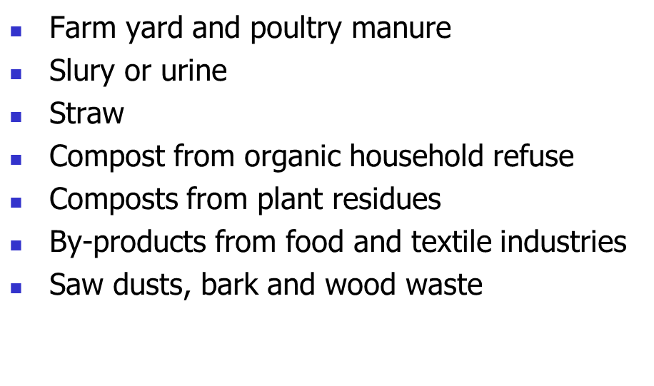
Table 2. Products for use in fertilization and soil conditioning

Slide 13
Table 2. Products for use in fertilization and soil conditioning
Wood ash
Natural phosphate rock
Calcium carbonate of natural origin (e.g. limestone)
Magnesium rock
Epsom salt (magnesium sulphate)
Sodium chloride
Clay, peat, Sulfur, Trace elements

Slide 14
Criteria for amending the list of permitted chemicals
Consistent to the principles of organic production
Approved chemicals are not available in sufficient quantity/and quality
In the evaluation process of substances for inclusion on lists all stakeholders should have an opportunity to be in involved
Any substance must comply with the relevant national regulations
The list in the CODEX standards is not all inclusive or exclusive

Slide 15
7 Adoption of Organic agriculture
The main factors affecting the adoption of organic techniques are:
Government policies promoting non-organic agriculture or discouraging organic agriculture
Promotion of non-organic techniques by extension staff
Promotion of non-organic techniques by commercial organizations
Effectiveness of non-organic techniques
Economic advantage of non-organic techniques
Lack of farmers knowledge of organic techniques
Aversion to organic techniques because they are perceived as long-term, old-fashioned or ineffective

Slide 16
7 Potential benefits of Organic agriculture
Potential benefits for organic
Soil improvement: physical, chemical and biological
Environmental gains and pollution control through the elimination of chemicals

Slide 17
Increased bio-diversity through mixed cropping, use of traditional crop varieties and the elimination of pesticides and herbicides
Increased plant resistance to pests and diseases
Improved water management
Increased productivity compared with traditional farming
Reduced cost of cultivation and increased net returns
Greater employment opportunities
No risk of pesticide contamination and related illness in humans and animals
Healthier food

Slide 18
Organic Certification
What is organic agriculture?
A production system that sustains the health of soils, ecosystems and people.
It relies on ecological processes, biodiversity and cycles adapted to local conditions, rather than the use of inputs with adverse effects.
It combines tradition, innovation and science to benefit the shared environment and promote fair relationships and a good quality of life for all involved. (IFOAM)

Slide 19
Is there a need for organic certification?
When organic farmers and traders are operating in an anonymous market, certification is developed to show and guarantee to consumers that a product has been produced in consistency with organic standards.
For small farmers/producers - when there is surplus & scale that that warrants new markets, certification becomes important.

Slide 20
Balance of interests
CONSUMER requires healthy and environmentally sound products and is willing to pay premium price
Trust
FARMER/PROCESSOR is producing according to certain standards (may be putting higher labour, etc.) is getting access to premium price markets

Slide 21
Organic Certification
What is organic certification…
  A procedure by which a third party gives written assurance that a product, process or service is in conformity with certain standards
  Intended to assure quality and prevent fraud
  A marketing initiative aimed at regulating and facilitating the sale of organic products to consumers

Slide 22
Organic Certification
What is a Certification Body…
  The organization performing the certification
  Might do the actual inspection or contract the inspection to an inspector or inspector body
  Certification decision is based on the inspection report, compliance with the standards, farm documentation and possibly complemented by other information sources as provided by the applicant

Slide 23
Organic Certification
Government
  Europe (EU regulation EEC2092/91)
  US (USDA-NOP)
  Japan (JAS)
  Canada
  Australia
  Thailand
  India
  China
  Nepal
Private Initiative
  IFOAM (www.ifoam.org)
  Assurance system is based on IFOAM norms (includes the IFOAM basic standard and IFOAM accreditation criteria)
  CertAll

Slide 24
Levels or Types of Certification
First Party Verification
  The producer with installed internal control system claims that the farm is organic
  The system exist in areas or communities where the producer and consumer know each other
  Farm or processing activity is open for consumer inspection
  Example is the Participatory Guarantee System (PGS)

Slide 25
Levels or Types of Certification
Second Party Verification
  Occurs when the consumer verifies the production system and farmer/processor adheres to the standard set by the consumers
  Consumers inspect the farms before a marketing agreement and activity takes place
  This type of guarantee system sits in a situation where there exist an organized consumer and producer group
  Example is the Community Supported Agriculture (CSA)

Slide 26
Organic Certification
Levels or Types of Certification
Third Party Certification
  Is done by a third party without direct interest in the economic relationship between the supplier and the buyer
  The certification is the formal and documented procedure by which a third party assures that the organic production standards are followed

Slide 27
Levels or Types of Certification
Third Party Certification
For two basic types of clients –
  Individual farm or processing enterprise
  Group certification through the installation of the Internal Control System (ICS)
    ICS is part of the documented quality assurance system that allows the external certification body to delegate the periodical inspection of individual group members to an identified body or unit within the certified operator

Slide 28
Certification Requirement/Processes
Study the organic standards
Compliance to the standards
Documentation and record keeping (day to day farming and marketing records and other activities)
Planning –written annual production plan
Application
Inspection
Fees (need for costing and scale for cost recovery)

Slide 29
What must be certified?
Farmer
Processor
Transporter
Trader
Shipping transporter
Exporter
Retailer
Consumer
*Those shaded in blue needs organic agriculture certification

Slide 30
Certification Process for
Individual Farm or Processor
Applicant apply for certification
Fill out forms and sign contracts
Inspector inspects the farm/processing plant
Farm walk
Check inputs and its sources
Check documentation
Exit meeting
Certification Comm. assigns inspector
Inspection report to be submitted to Certification Committee
Certification Committee deliberation
Release of Certification Decision

Slide 31
Certification Process for
Smallholder Group
Applicant apply for certification
Fill out forms and sign contracts
Inspector inspects the internal control system of the organization
Farm walk (random sampling)
Check inputs and its sources
Check documentation
Exit meeting
Certification Comm. assigns inspector
Inspection report to be submitted to Certification Committee
Certification Committee deliberation
Release of Certification Decision

Slide 32
Certification Costs

Slide 33
Participatory Guarantee Systems
(PGS)
Participatory Guarantee Systems (PGS) are locally focused quality assurance systems. They certify producers based on active participation of stakeholders and are built on a foundation of trust, social networks and knowledge exchange
PGS represent an alternative to third party certification, especially adapted to local markets and short supply chains. They enable the direct participation of producers, consumers and other
stakeholders in:
• the choice and definition of the standards,
• the development and implementation of verification procedures,
• the review and decision process to recognize farmers as organic

Slide 34
(Continue)
Participatory Guarantee system(PGS)offers the following benefits:
Improved access to organic markets through a guarantee system for small scale producers
Increased education and awareness among consumers
Promote short supply chains and local market development
Empowerment

Slide 35
Economics of Organic Agriculture

Slide 36
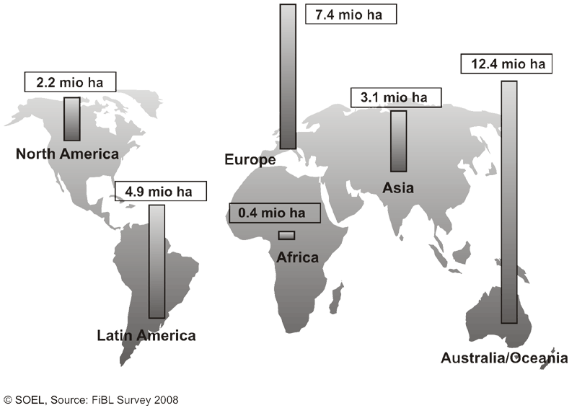
Certified organic production: over 30 million hectares, 138+ countries

Slide 37
OA to Nepal
Until the 1950s Nepalese farming systems were largely organic. Introduction of green revolution agriculture in South Asia persuaded Nepal to use agrochemicals.
In recent years, reflecting the growing understanding of the adverse impacts of chemical-based agriculture on health and the environment, organic farming is regaining some of its popularity among the farmers, academicians and entrepreneurs.
However, the organized organic market in Nepal is very small. The International Federation of Organic Agriculture Movement reports that 9789 ha (0.23% percent of total agricultural land) of land is managed by 1470 producers in Nepal under organic farming (IFOAM, 2012).
Further, about 90 metric tons of certified organic coffee is produced in some 210 ha of land and 59 ha are under conversion (Shrestha, 2011). About 7 percent of traditional tea produced in Nepal is organic.

Slide 38
Organic farmers diversify their businesses by growing several crops at one time, often having both livestock and field crops, and sometimes value-added enterprises as well. The diversification reduces economic risk.
Many experienced organic farmers have crop yields as high as, or higher than, the average conventional yields. However, the average organic crop yields are often lower than the average conventional yields.

Slide 39
Cost of production
Organic farms have lower costs of production than conventional farms, with much less emphasis on purchased inputs. Synthetic fertilizer and pesticide purchases are eliminated, and costs of purchased feed, veterinary bills, and replacement livestock are lower. In addition, organic farmers have lower fixed (overhead) costs for depreciation and interest charges attached to capital inputs, such as machinery and equipment. On balance, input costs are lower on organic farms.
Organic farming methods replace herbicides with mechanical cultivation and other management practices to provide weed control. Tillage for weed control after plant emergence is relatively shallow with low potential to compact the soil.
Some argue that weed control increases tillage requirements and costs. In practice, this has not been the case. By improving soil structure and with good management practices, organic farmers have discovered that they require no more, and in some cases less, tillage than their conventional neighbors.

Slide 40
Net farm income
The net income of organic farms appears to be slightly higher than for conventional farms. In general, expenses are lower and the income is greater (if there is good price premium).
Price premiums vary between crops and over time. The organic industry is changing rapidly, leading to price instability. For example, a high premium price for one crop can lead many farmers to grow that crop. The market is then flooded and the price plummets.
Many believe that over time, the price premiums will stabilize. The high value of organic crops is offset by including lower-value crops in rotation. Green manures and pasture crops, though valuable in their soil improvement ability, do not generate high economic returns.
Intercropping is one way to incorporate low-value crops into the rotation, while still growing valuable cash crops. Crop rotations also reduce risk. By growing several crops at any one time, the farm income will be buffered from both price fluctuations in any one crop and crop failure.

Slide 41
Marketing
The demand for organically-produced foods is growing rapidly, in Canada, North America, Japan and Europe. This rapid growth has resulted in fluctuations in the market.
For example, some of the markets have very specific demands in terms of crop quality and the demands change from year to year.
The organic industry is still developing, and the infrastructure in terms of transportation systems, wholesalers and distributers is in its infancy.

Slide 42
Economic benefits
Net income = (price x quantity) – total costs
Generally, organic farmers earn more.

Slide 43
Food security benefits
Higher incomes
Higher yields
Diversified production
Improved nutrition

Slide 44
Environmental Benefits
Less pollution
Improved soil, incl. increased water retention and less soil erosion
Enhanced biodiversity
No genetic contamination

Slide 45
Environmental Benefits, cont’d
Mitigated climate change
Reduced energy consumption
Landscape services

Slide 46
Social & cultural benefits
Benefits for smallholders
Women’s empowerment
Builds on traditional knowledge
Reduced rural-urban migration
Improved health & safety
Community revitalization

Slide 47
OA as an export opportunity—rapid global market growth

Slide 48
OA as an export opportunity
Global sales growth rates at least double those of conventional food products
Acute supply shortages since 2005
Developing country exports rising fast
Price premiums

Slide 49
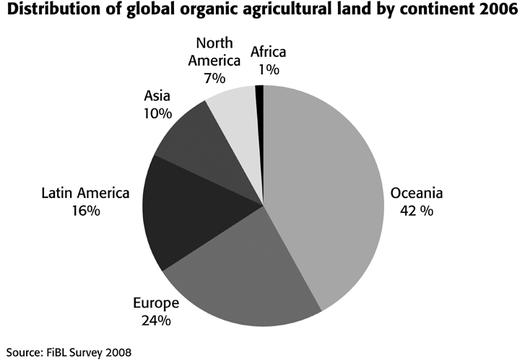
Regional distribution of certified organic production 2006

Slide 50
Production challenges
Little or no government support (policies, ag extension, R&D)
Conversion period
Knowledge intensive
Sometimes lack of organic inputs
Lack of secure land tenure

Slide 51
Export challenges
OA exports must:
Meet Sanitary and Phytosanitary (SPS) requirements in import mkt (same as for convent’l products)
Meet requirements of OA regulations & be certified by approved cert. body
Meet additional requirements of private standards (sometimes)

Slide 52
Export challenges
Agric. Subsidies in import markets
Need for market information
Consumer preferences for local food
Lack of harmonization, equivalence & mutual recognition

Slide 53
Organic commodity in Nepal
Rice: Conventional farming is more productive and offers significantly higher profits relative to organic rice farming. The average cost of production of organic rice is higher than in conventional production. Labor productivity is higher in conventional rice relative to organics even though both types of farmers make net positive profits .
Maize: While there are no significant differences in yield, both organic and conventional maize farms have negative profits in due to low productivity and high labor costs. However, the negative profits are significantly smaller in organic maize relative to conventional farming. Organic maize farms have significantly lower costs relative to conventional farms.

Slide 54
Tea: Conventional tea productivity is higher than organic tea productivity, but there are no significant differences in profits. Productivity may be lower in organic tea because of inadequate supply of organic manure. Farmers note that organic tea flowering or flushing is slower and leaves are more difficult to pluck in comparison to conventional farming, where new growth is succulent and easy to pluck. While production costs of conventional tea, in terms of fertilizers and pesticides are higher, this is offset by higher labor costs in organic production. The higher price organic tea fetches does not make up for the high cost of production and there is no significant differences in profits.
Coffee: Profits in organic and conventional farms are negative. However, net revenues in organic coffee farming are significantly higher than conventional coffee. While there is no significant difference in yields between the two types of coffee, conventional coffee is significantly more costly to produce. This is because of the high costs of fertilizers and pesticides used .

Slide 55
Cauliflower: There are no significant differences in productivity or profits between conventional and organic cauliflower. This may be partially because organic producers do not get a premium price for their product, in spite of growing awareness about the health hazards of consuming vegetables subject to high doses of pesticides. The average cost of production of organic cauliflower is lower on an acreage basis, but higher in terms of per unit cost.

Slide 56
What Nepal should do for developing OA?
Assess national organic sector & policies
OA action plan
Consider supporting OA R&D, extension services, certification costs, development of domestic market, exports, harmonization

Slide 57
Other factors contributing to success
Community organization
Group certification

Slide 58
Key Role of the government:
Establish competent authority
Register private certification body
Adopt and adapt codex standards on organic production, labeling and marketing
Develop list of plant and plant products

Slide 59
Key Role of the government:
Develop list of permitted substances for the production
List of substances for use in soil fertilization and conditioning
List of substances for plant pest and disease control
Develop a list of additives for use in food items
List of processing aids
Identify production areas/units:-
With full description
Unit or area comply with organic guidelines

Slide 60
Key Role of the government:
Development of inspection protocols
Development of certification tools, procedures and documentation
Development of tools, procedures and documentation of Participatory Guarantee System (PGS)- for community based production

Slide 61
QUESTIONS FOR DISCUSSION
What is your understanding of the term organic?. What are the reasons you consider to be the reasons you consume organic products?. Kindly rank them in terms of the most important
Quality attributes desired by organic consumers?
Who gains what in organic business?
Discuss networking of organic business and traceability of organic products

Slide 62
QUESTIONS FOR DISCUSSION
What needs to be done to expand organic market in Nepal?
The need, production, distribution and cost of organic farm inputs
The need, role and responsibilities and costs of brokers in organic marketing
Fairness in organic business: margins for chain actors

Slide 63
QUESTIONS FOR DISCUSSION
Is it a good idea to form an organic consumers group, in which you regularly discuss organic consumption?. What other methods would you use to share information on organic products?
Is there a price difference between organic and conventional products in Nepal? Are you satisfied with the pricing of the organic foods
Should organic consumers pay more for organic food than other people?. If yes by what percentage? Why? Give reasons

Slide 64
QUESTIONS FOR DISCUSSION
The benefits and practicalities of networking in organic business
Market governance. Justify why organic products are highly priced “premium prices”
How can the organic consumers be organized to access the products they need?

Slide 65
QUESTIONS FOR DISCUSSION
Why are consumers willing to pay more for organic products
As an organic consumer, what characteristics do you consider when purchasing organic products?
As an organic consumer, do you always get access to the products you want on time?
How do you know that the product you are purchasing is really organic
How you know where to buy products, especially when they are scarce?

Slide 66
QUESTIONS FOR DISCUSSION
List methods that exist to ensure you access to organic products. Give advantages and disadvantages of each. Which method can be improved and how?
Give opinion on what should be done to give assurance that organic products are really organic
Give opinion on what should be done in ensuring access to organic products?
Should the government intervene in the regulation of organic industry? If yes, how?

Slide 67
Reference
FAO. 1999. Guidelines for the production, processing, labeling and marketing of organically produced foods. FAO codex committee on Food labeling, Rome, 33pp

Slide 68

THANK YOU

