Slide 1
Secondary Nutrients
Ca, Mg, S

Slide 2
Sulphur (S)
Sulphur is an essential nutrient for members of the plant and animal kingdoms.
It is present in the atmosphere as SO2 Gas or H₂S gas.
The inorganic component of soil sulphur is in the form of sulphate and constitutes only a minor portion of the total sulphur content of soils.
The major reserve of the element in soil is the organic fraction, and the storehouse is unlocked only through biological decomposition (Alexander, 1961).
Sulfur enters the soil in the form of plant residues, animal wastes, chemical fertilizers, and rainwater. Occasionally, elemental sulfur is deliberately added for the control of certain plant pathogens or in the reclaiming of alkali soils. A large part of the sulfur in the soil profile is in organic combination and it should be mineralized into inorganic forms by microbial decomposition.

Slide 3
The organic portion of sulphur is found in 3 forms.
HI (hydroiodic acid ) Reducible S:
This fraction is organic S that is reduced to H2S by hydroiodic acid. About 50 % of organic S occurs in this fraction. Examples include phenolic sulfate, sulfated polysaccharides, sulfated lipids etc.
Carbon-bonded S:
The S-containing amino acids cystine and methionine are principal components of this fraction, which accounts 10-20 % of total organic S.
Residual S:
The remaining unidentified organic S is considered to be residual. The various transformations of sulphur in the biosphere can be summed up as a cyclic reaction involving: (1) decomposition of organic sulphur compounds into subunits which are, in turn, converted into inorganic compounds through a process of mineralization, (2) assimilation of sulphur into the protoplasm of micro-organisms, a process referred to as immobilization, (3) oxidation of inorganic sulphur compounds into elemental sulphur, and (4) reduction of sulphate.

Slide 4
The overall sequence of transformation ofS ulphur
Sulphur Mineralization
Sulphur is bound in organic state in proteins of vegetable and animal origin and
in the protoplasm of microorganism in the form of sulphur containing amino acids (cystine and methionine) and B-vitamins.
The con­version of organically bound sulphur to the inorganic state(SO₄²⁻) is termed as mineralization of sulphur and is mediated through microorganisms. When plant and animals residues are returned to the soil, they are digested by microorganisms, releasing some of the S as SO₄²⁻;However, most of the S remains in organic form and eventually become part of the soil humus. Degradation and release of S from the large humus fraction are limited and slow.

Slide 5
S-Immobilization
Immobilization is the conversion of inorganic sulphur i.e. SO₄²⁻ to organic S.
S content is low in microorganisms. So immobilization occurs due to microbial assimilation of soil available inorganic S. As long as there is less sulfur in the organic matter than required for microbial proliferation, immobilization occurs.
Generally,if the C:S ratio is greater than 400:1, Immobilization occurs and below that mineralization takes place. After decomposition of residues, microorganisms die and immobilized organic S is again mineralized and becomes available to plants. Thus immobilization of sulphur is a temporary process.

Slide 6
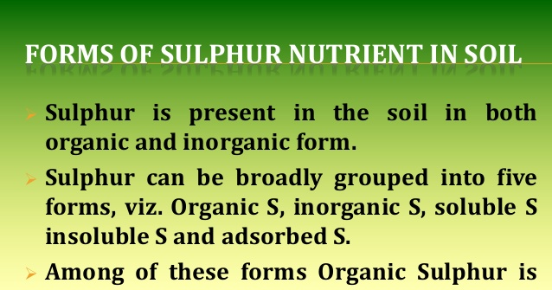
important

Slide 7
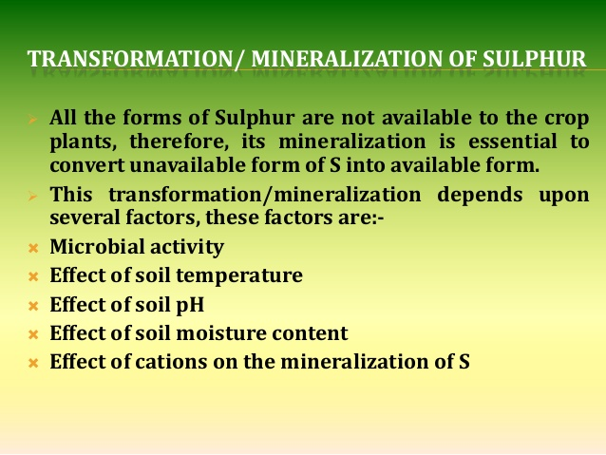

Slide 8
Factors affecting S Mineralization & Immobilization
Factors affecting S mineralization are,
C:S Ratio
Generally,if the C:S ratio of organic matter is greater than 400:1, Immobilization occurs and below that mineralization takes place.
S content of OM
Greater the S content of OM,faster the mineralization.
Soil temperature
Mineralization of S is impeded at 10 degree C,increases with increasing temperature upto 20-40 degree C and then decreases above 40.
Soil moisture
Optimum moisture for mineralization is 60 % of field capacity.
Soil PH
Mineralization increases upto the PH value of 7.5.

Slide 9
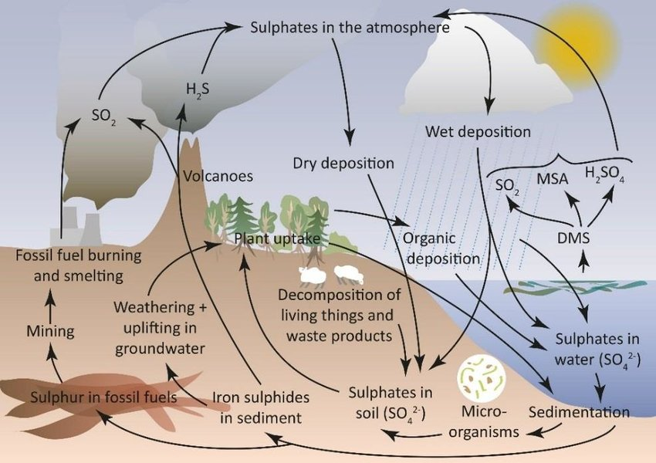

Slide 10
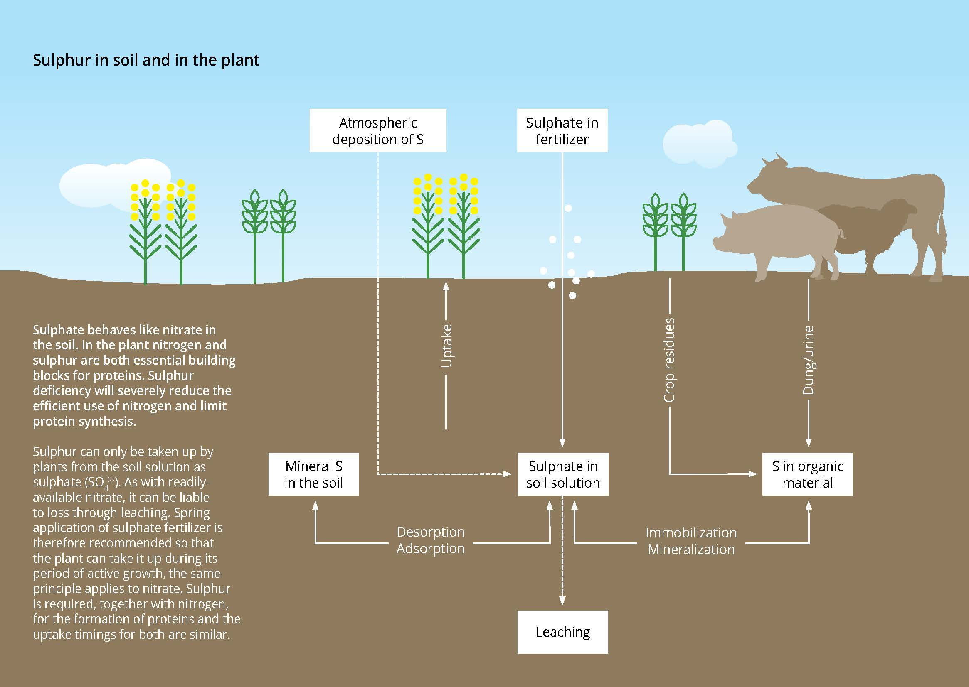
S in plant and animals

Slide 11
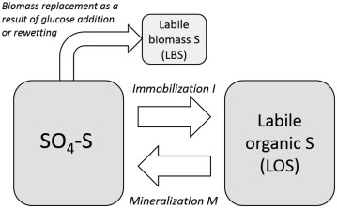

Slide 12
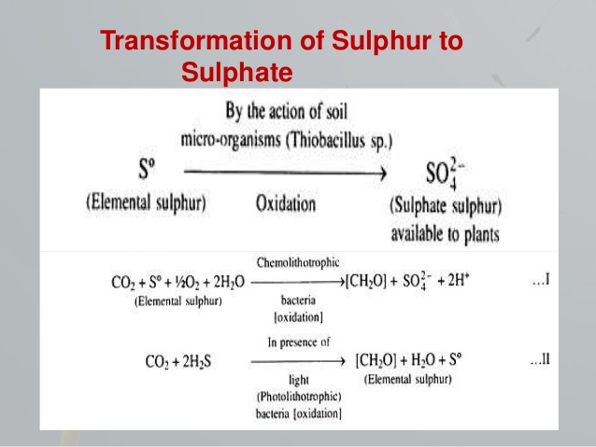

Slide 13
Animals
Plants
Organic residues
Carbohydrates and proteins (susceptible to microbial attack)
lignins, fats, waxes, resins etc (resistant to microbial attack)
i)Mineralization in to CO_{2,}
NH_{4,} NO_{3,} NO₂
ii)Immobilization of
C, N, P, S in microbial cells
Humus

Slide 14
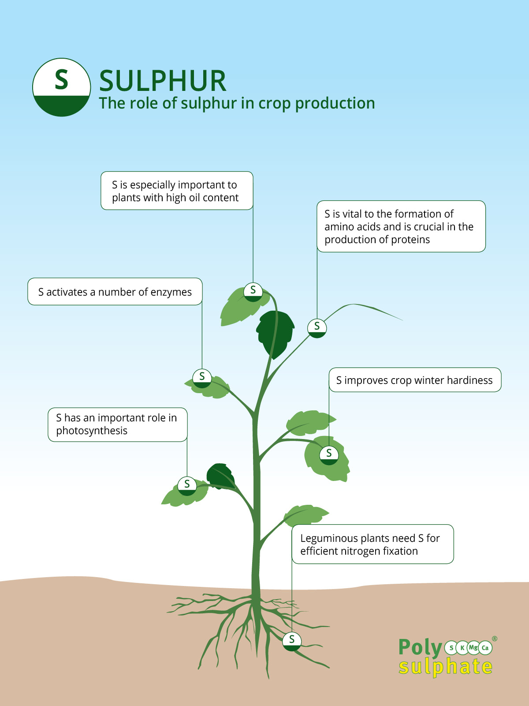
Function of sulphur

Slide 15
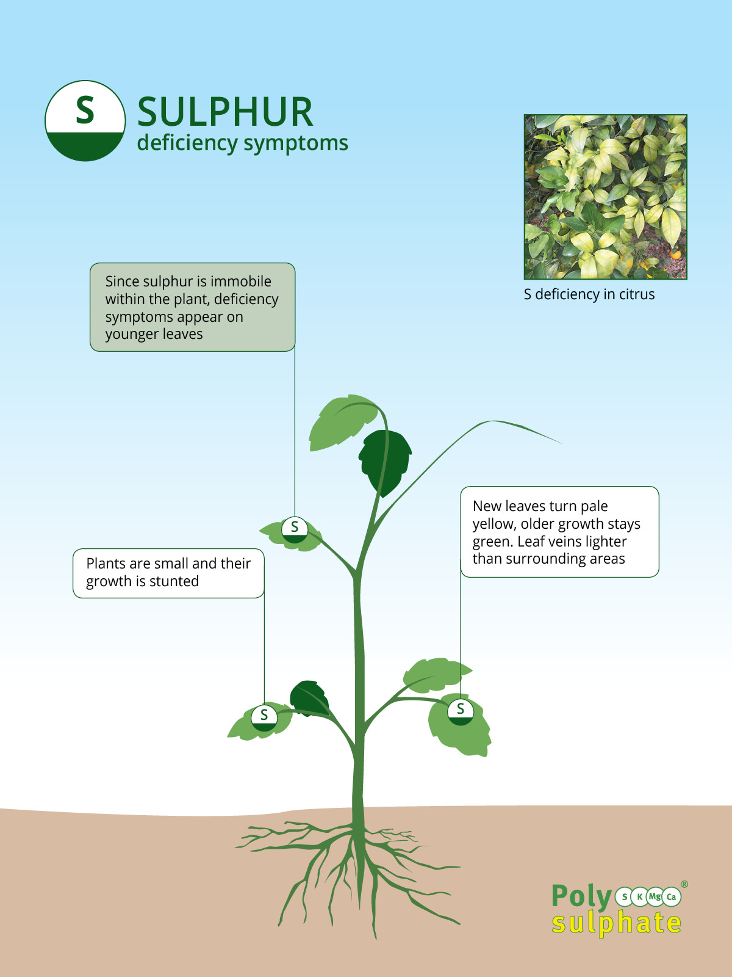
S-deficiency

Slide 16
Calcium
The calcium content in soil, plants and liming materials are generally expressed as CaO or as elemental calcium with a factor of 0.72 between them.
The total calcium content in soil is very variable depending on the parent materials
Soils have considerable Ca when soil is derived from limestone, igneous rocks as granite, gneisses and schists
Sandstones and shales also contain some amount of Ca (little)
Ca adsorbed in excahnge complex and soil solution are available to the plants
Lower the soil pH lesser the Ca content in soil solution and exchange sites

Slide 17
Calcium is the fifth most abundant element in the earths crust.
Ca content in soils as CaO is about 1 percent, except soils containing Calcite or Gypsum.
Plant absorb Ca in Ca++ form.
Sources and Forms of Calcium in soil are
Primary Mineral form:
Calcium in soils is mostly present in primary minerals like anorthite-rich minerals of plagioclase series, augite, hornblende and epidote. Plagioclase minerals weather more easily than other minerals.
b. Calcium carbonate:
Calcareous soil of semi arid and arid region contain calcium carbonate (CaCO3) or dolomite (MgCO3.CaCO3). Recently developed soils of humid region may contain calcium carbonate inheriting from the parent rocks.
c. Liming materials as CaO, Ca(OH)2, CaCO3.MgCO3, Ash, Bone meal

Slide 18
c. Other salts:
Calcium may be present in soils in the form of simple salts, such as gypsum, calcium nitrate, calcium carbonate and calcium phosphates.
d. Exchangeable calcium:
Calcium cations adsorbed in exchange sites of the clay micelle is exchangeable calcium..
d. Ca containing fertilizer materials
Triple super phosphate contains 12-14% Ca, single super phosphate (18-20%) and calcium nitrate (19% Ca)
Animal and municipal waste contain approximately 2-5% Ca.
Synthetic chelates of Ca as Ca-EDTA contain approximately 3-5% Ca. This Chelated Ca can be used for foliar spray

Slide 19
Soil calcium deficiency
Calcium deficiency in the soil is caused by,
Crop removal
Leaching loss
Conversion of soluble calcium to less soluble forms.
Factors affecting Calcium availability to plants are
Total Ca concentration in soil and Ca supplying capacity of soil
Soil pH
Ca+2 saturation on exchange sites
Type of soil clays (2:1 or 1: 1 type)
Ratio of Ca to other cations in soil solution.

Slide 20
Calcium is an essential macronutrient in plants, with concentrations in the shoot ranging from 0.1 to over 5% of dry wt (Marschner, 1995; White and Broadley, 2003)
The most important sources of fertilizer Ca are
calcium carbonate (CaCO₃) marketed as chalk, ground chalk, screened chalk, or ground limestone,
calcium hydroxide (Ca(OH)₂) sold as hydrated lime or slaked lime, and
calcium oxide (CaO) marketed as burnt or quick lime (Cooke, 1972). Other sources are ground magnesium limestone, lump chalk, marl, and calcareous sea sands. The rate at which the Ca in these fertilizers becomes available to the forage depends on particle size (Cooke, 1972).

Slide 21
Calcium stimulates structure and workability
The nutrient calcium is very important for both soil and plant.
Calcium is an important factor for cell wall and membrane stability which helps in building block for cell walls and contributes to the cell extension and growth of a plant.
Calcium acts as a second messenger in developmental & physiological processes, including response of plants to biotic stress helps to become better resistant during growth
calcium influences the absorption of trace elements. In other words, one nutrient reinforces the other.
Calcium also contributes to a better structure and good workability of the soil.

Slide 22
Besides its structural role, the main function of calcium lies in its ability to serve as a second messenger in a variety of processes ranging from root or pollen tube growth and fertilization (Michard et al., 2011; Monshausen et al., 2011; Ortiz-Ramírez et al., 2017; Zhang et al., 2017)
responses to abiotic (Knight et al., 1991, 1997) as well as biotic stress (Blume et al., 2000; Lecourieux et al., 2002, 2005).
rises in the cytosolic Ca²⁺ concentration (intracellular fluid) thereby serve as a signal, which is decoded into downstream responses (McAinsh and Pittman, 2009; Dodd et al., 2010; Thor and Peiter, 2014).

Slide 23
To exert this function, free Ca²⁺ levels in the cytosol under non-stimulated conditions need to be kept at a low level of around 0.1 μM. This is achieved by the action of biochemical buffers (Sanders et al., 1999) as well as H⁺/Ca²⁺ antiporters and Ca²⁺-ATPases, which actively deliver Ca²⁺ into the apoplast or intracellular stores (Dodd et al., 2010; Kudla et al., 2010, 2018).
To generate a Ca²⁺ signal, the ion thus can move down the concentration gradient into the cytosol through channel proteins in the plasma or internal membranes
Calcium not only is a nutrient itself, interestingly in its function as second messenger, it is involved in signaling nutrient availability and changes thereof.

Slide 24
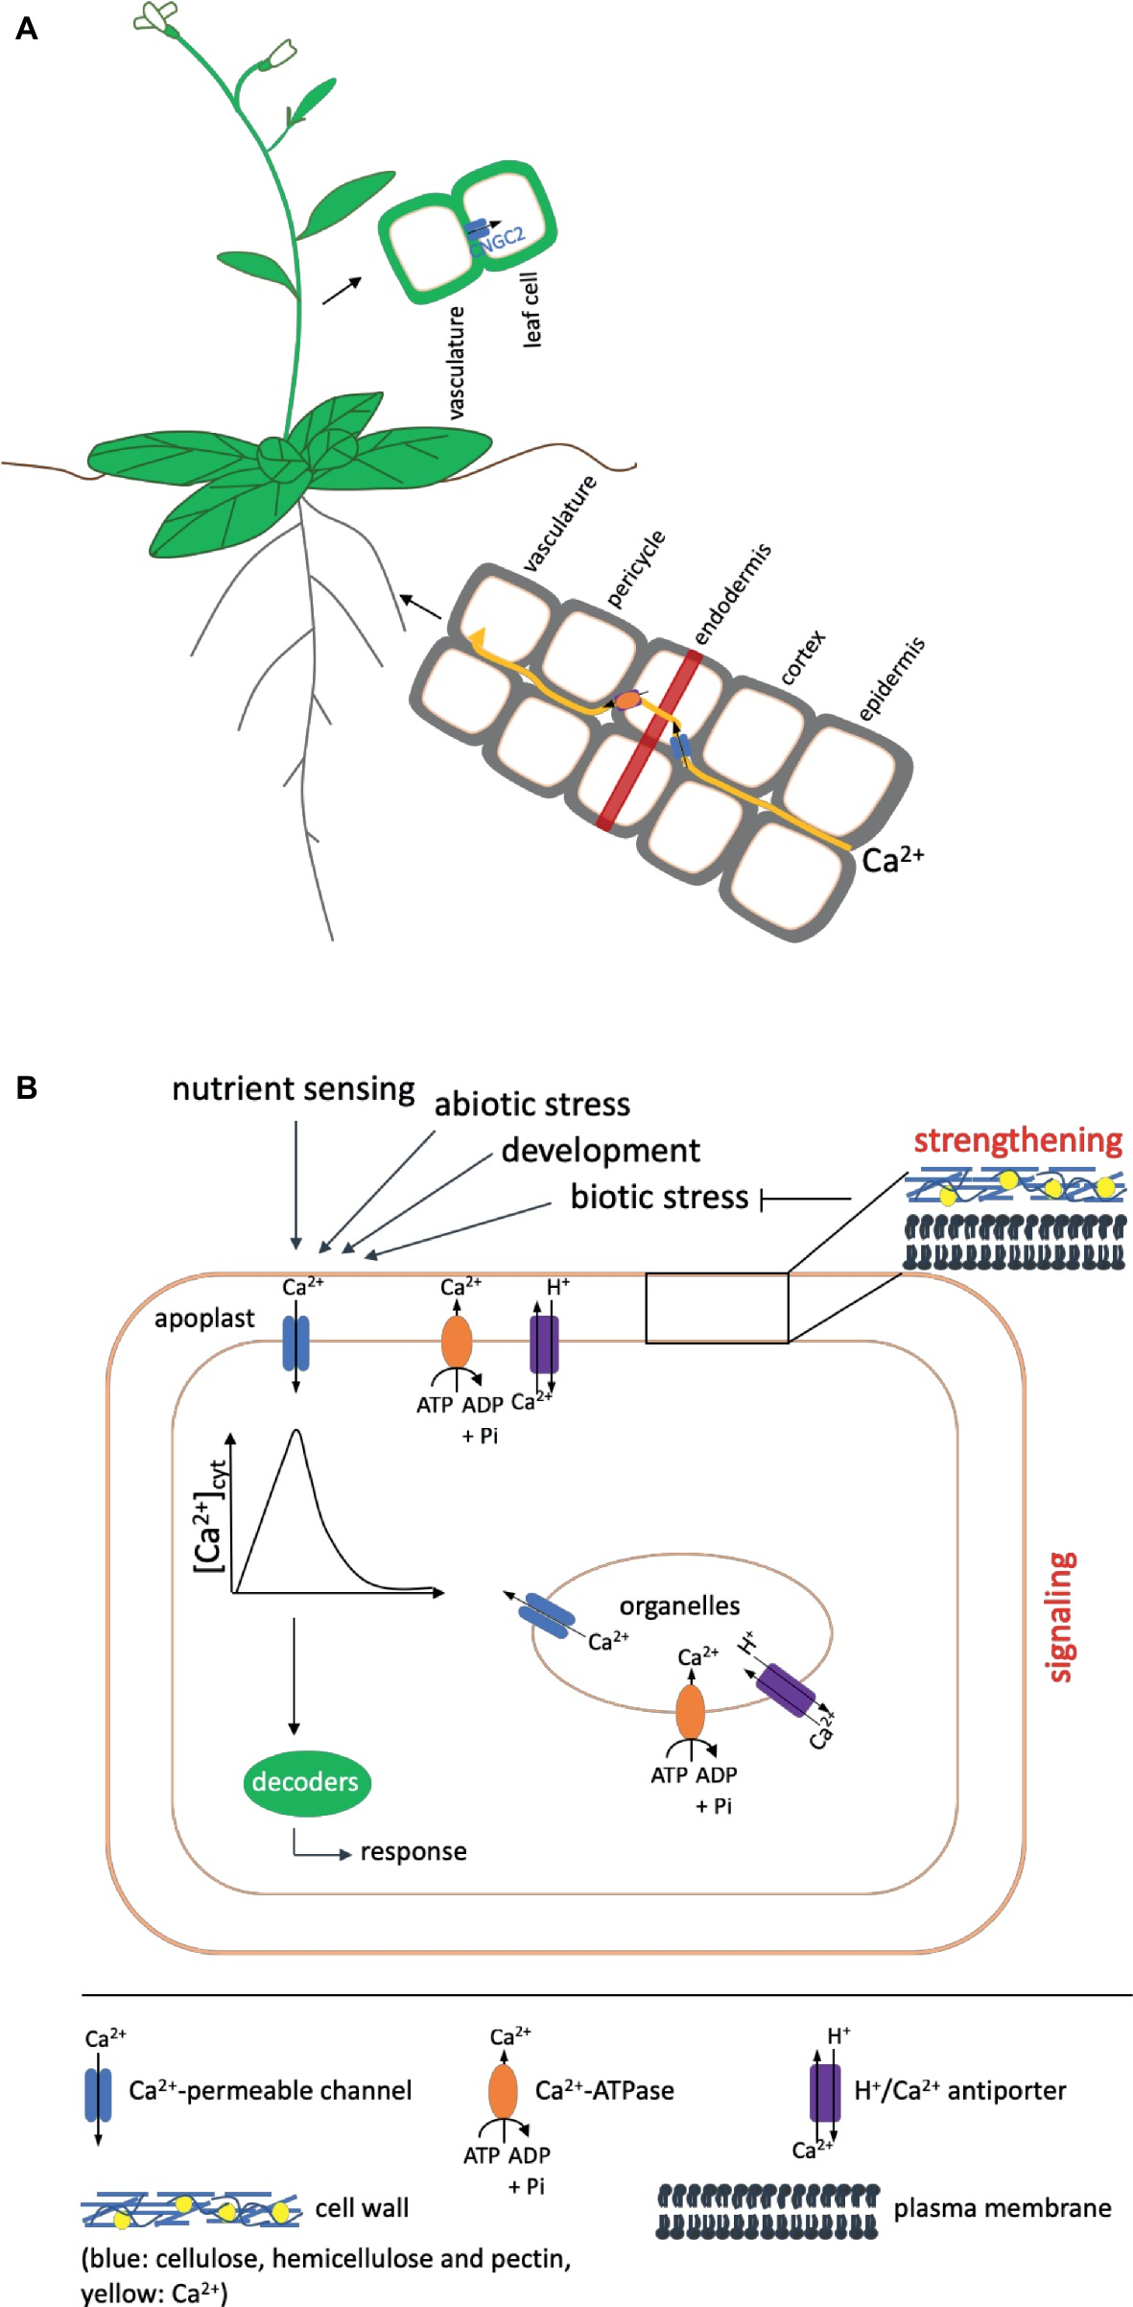
To generate a Ca²⁺ signal, the ion thus can move down the concentration gradient into the cytosol through channel proteins in the plasma or internal membranes
apoplast is the space outside the plasma membrane within which material can diffuse freely

Slide 25
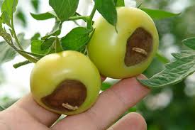
Calcium Deficiency
Deficiency symptoms occur however more often in developing tissue such as young leaves and fruits, due to low remobilization from old to young tissue via the phloem.
This leads to a strong dependency on supply via the xylem and thus on transpiration, which in young tissues is not very high.
Resulting diseases are for example tipburn in lettuce or blossom end rot in tomato (White and Broadley, 2003; Hirschi, 2004).

Slide 26
Calcium (Secondary Nutrient)
Calcium deficiency made worse by
Acidic soils
Sandy or light soils (leaching)
Acid peat soils
Soils rich in sodium
Soils rich in aluminium
Drought conditions
Fruit high in nitrogen or potassium
Large fruit
Calcium is important for
Cell division
Cell elongation
Proper working of cell membranes
Permeability of cell membranes

Slide 27
Ca²⁺ uptake and the functions it fulfills in the plant. Shown are only components mentioned in the text. (A) Ca²⁺ is taken up by the root and transported to the shoot in a mainly apoplastic way to avoid interference with its function as second messenger. To circumvent the casparian strip (indicated as red band), it has to enter the cytosol of the endodermal cells via channel proteins (shown in blue) and subsequently be exported into the apoplast via Ca²⁺-ATPases or Ca²⁺/H⁺ antiporters (shown in orange) (Clarkson, 1993). Influx into leaf cells after unloading from the vasculature in Arabidopsis has been proposed to occur via CNGC2. (B) Ca²⁺ fulfills two functions in the plant: It has a strengthening effect on cell walls and membranes and acts as a second messenger in signaling events during development and in response to environmental cues.
A strengthened cell wall protects against pathogens (indicated by a blunt arrow).
In addition, different kinds of biotic stress also induce signaling cascades, in which calcium serves as second messenger.
In such signaling cascades, like in those induced by other events, Ca²⁺ enters the cytosol from compartments of higher concentration (apoplast, organelles) via channel proteins (blue) to induce an increase in the cytosolic calcium concentration [Ca²⁺]_{cyt}, the Ca²⁺ signal, which is decoded by downstream components into an appropriate response.
The signal is terminated by transport of Ca²⁺ out of the cytosol via Ca²⁺-ATPases (shown in orange) or H⁺/Ca²⁺ antiporters (purple) in the plasma or organeller membranes. The presence of these export proteins differs in different organelles.
Arrows on top indicate events that induce Ca²⁺ signals.

Slide 28
Magnesium
Magnesium (Mg) is one of the three secondary nutrients required by plants for normal, healthy growth.
Function of magnesium
Many enzymes in plant cells require magnesium in order to perform properly.
The most important role of magnesium is as the central atom in the chlorophyll molecule. Chlorophyll is the pigment that gives plants their green color and carries out the process of photosynthesis.
It also aids in the activation of many plant enzymes needed for growth and contributes to protein synthesis.

Slide 29
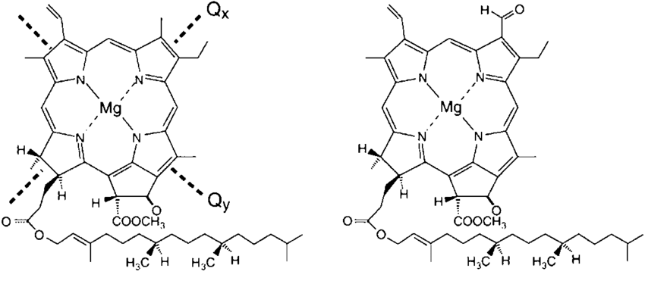
Structure of Chlorophyll

Slide 30
It is also active in the metabolism of phosphorus. A deficiency rarely affects yield but can reduce the nutritional quality of crops.
magnesium influences nitrogen metabolism and is important in the assimilation of carbon dioxide during photosynthesis.
An antagonistic relationship exists among calcium, magnesium and potassium

Slide 31
Deficiency:
Magnesium is mobile within the plant so deficiency symptoms appear first in older leaves.
The symptoms show up as yellow leaves with green veins (i.e. interveinal chlorosis).
Magnesium availability is not significantly affected by the pH of a soilless growing medium. However, it does become more available for plant uptake as the pH of the growing medium increases.
Magnesium deficiency often is caused by lack of application, but it can be induced if there are high levels of calcium, potassium or sodium in the growing medium.

Slide 32
Magnesium is abundant in the earth's crust.
It is found in a wide variety of minerals. Magnesium becomes available for plant use as these minerals weather or break down.
the addition of dolomitic limestone in the crop rotation, when needed, should supply adequate Mg for crop growth.
Magnesium is held on the surface of clay and organic matter particles.
Although this exchangeable form of Mg is available to plants, this nutrient will not readily leach from soils.

Slide 33
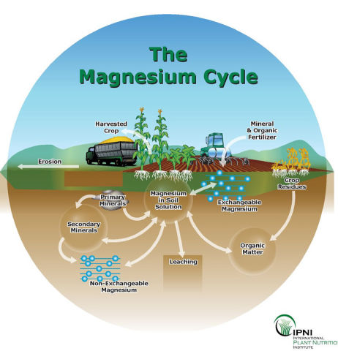

Slide 34
The most common fertilizer source of Mg is dolomitic limestone.
When a soil test shows that lime is needed to raise the soil pH and soil Mg concentrations are low to marginal, apply dolomitic limestone to raise soil pH and add Mg to the soil. Limestone has a low solubility and breaks down slowly in soils; therefore, if a quick response to Mg is needed,
a more soluble source of Mg fertilizer should be considered (e.g., Epsom salts).

Slide 35
Element Name of Material Chemical Composition % of Element
Mg Dolomitic limestone CaMg(CO3)2 3-12
Mg Epsom salts MgSO4.7H2O 9.6
Mg Kiserite MgSO4•H2O 18.3
Mg K-Mag K2SO4•2MgSO4 11.
Mg Magnesium nitrate Mg(NO3)2 19
Mg Magnesia MgO 55-60
Mg Basic slag 3

Slide 36
Magnesium (Secondary Nutrient)
Magnesium deficiency made worse by
Sandy soils
Acidic soils
Potassium rich soils
Soils receiving high potash applications
Cold wet periods
Magnesium is important for
Part of chlorophyll molecule
Phosphate metabolism
Nitrogen metabolism
Protein synthesis
Water uptake by the plant

Slide 37
Sulphur (Secondary Nutrient)
Sulphur is important for
Protein development (amino acid)
Coenzyme A Vitamins
Sulphur deficiency made worse by
Acidic soils
Light, sandy soils (leaching)
Low organic matter
Poorly aerated soils (waterlogged soils)
Areas with low industrial emissions

