Slide 1
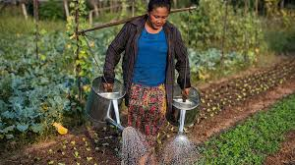
STATUS OF ORGANIC FARMING IN NEPAL
ASHOK ACHARYA
DEPARTMENT OF SOIL SCIENCE AND AGRI-ENGINEERING
SSC-05M-2018

Slide 2
OUTLINE
Introduction
Organic agriculture in Nepal
History of organic agriculture in Nepal
Status of organic agriculture in Nepal
Polices and guidelines regarding organic agriculture
Prospects
Challenges
Conclusion

Slide 3

To be considered “organic”:
– must be produced without synthetic pesticides, fungicides
or herbicides.
– Can not be grown by use of genetic engineering
– Bans use of sewage sludge as fertilizers
– No irradiation of food to preserve it
– No use of hormones and/or antibiotics in organic meat &
diary products
Strict farming methods = costly production

Slide 4
Organic agriculture in Nepal
Organic agriculture is a holistic production system which enhances agro-ecosystem health, biodiversity, & soil biological activity. (FAO/WHO Codex Alimentarius Commission, 1999).
The traditional system of agriculture in Nepal was organic but with the change in time, the practices changed more towards inorganic, which is a direct threat to agriculture productivity, environmental & human health (Krishna P. Paudyal, 2010).
Over a century, traditionally farmers in hills and mountains are following the farming practice, which is similar to organic farming. However, many of them have no idea that their traditional practice is an organic agriculture.

Slide 5
History of organic agriculture in Nepal
Organic movement began in the 1930s and 1940s as a reaction to agriculture's growing reliance on synthetic fertilizers.
Sir Albert Howard is widely considered to be the “father of organic farming”
In Nepal INSAN started an organized effort to promote organic farming in Nepal followed by Judith Chase who started organic farming in Bhaktapur in 1987.
Organic agriculture was first appeared as one of the priority sectors in Nepalese agriculture since 10th Five Years Plan (2059/060-2063/064)

Slide 6
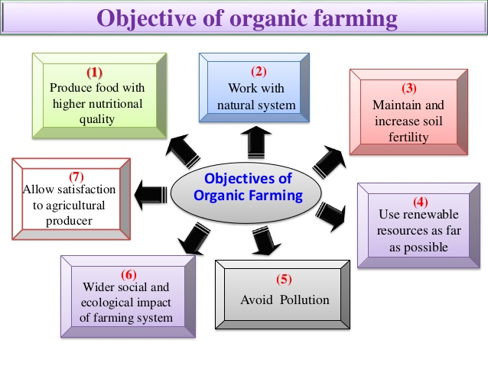
Types of organic agriculture in Nepal

Slide 7
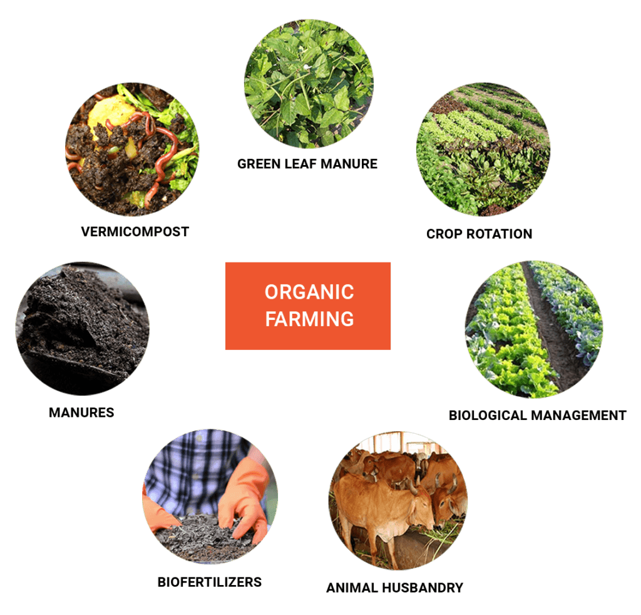
Types of organic agriculture in Nepal

Slide 8
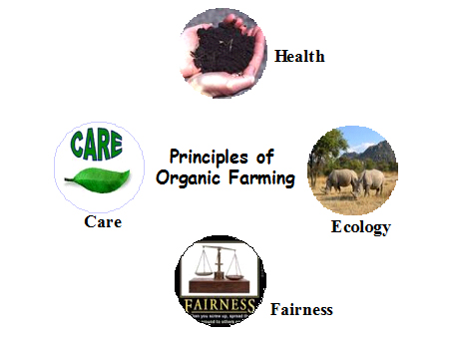

Slide 9
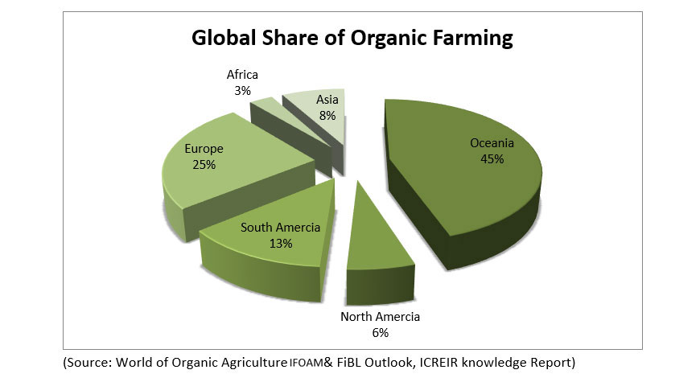
Status of organic agriculture in World
Global organic area continues to grow – Over 71.5 million hectares of farmland are organic. (The World of Organic Agriculture, 2020)

Slide 10
Status of organic agriculture in Nepal
It has been reported that the total land under organic management in Nepal is estimated to be 9789 ha. which is 0.23% of total agricultural land. (Ambassador report, 2015)
The national agriculture policy 2061 clearly stated that the promotion of organic agriculture is only for export, the organic farming is limited in only export oriented commodities such as honey, coffee, tea, large cardamom, ginger etc.(Acharya, 2019)
Out of total 804 ha, of land is share of organic coffee production in Nepal. (Willer and Lernoud, 2019).
Tea and coffee have already been certified as organic products and have good export returns in Nepal.(Khanna, 2016)

Slide 11
Status of organic agriculture in Nepal
Nepalese organic products reach standard for Nepalese market but competing with the international market is too hard due to complicated certification process.(Tamang & Acharya, 2011)
Adoption of organic farming is quite slow, market for organic products is not well developed & no market statistics are available in Nepal (Bhatta et al, 2008)
For example due to the lack of accredited laboratory facility, several cases of return of the certified organic products (honey) had been seen in the recent past. .(Tamang & Acharya, 2011)
Great possibility of organic farming because many places are still in organic in nature and yet to be not reached the modern technologies and chemical fertilizers.

Slide 12
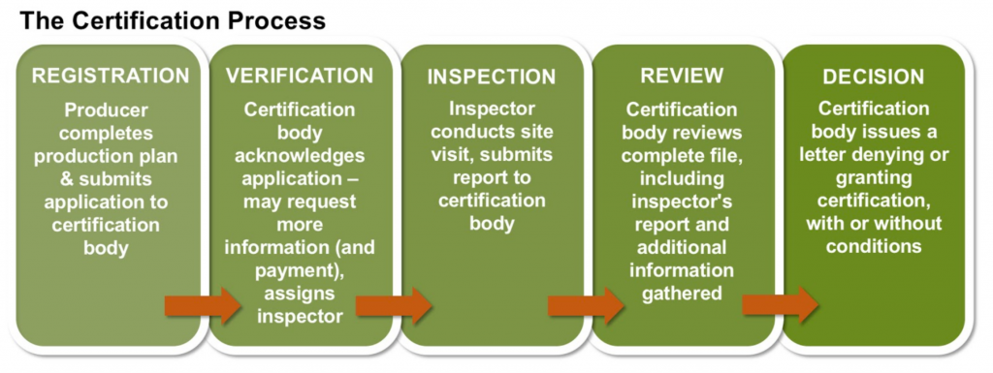

Slide 13
PROSPECTS OF ORGANIC FARMING
Consumers acceptance
Environmental friendly
Higher biodiversity
Better soils

Slide 14
Policies regarding OA in Nepal
The Agricultural Perspective Plan (APP) 1995 was its emphasis on Integrated Pest Management (IPM) from the realization of harmful effects of chemical pesticides.
The constitution of Nepal 2015: “Right Regarding Environment and Health” as the fundamental right of a citizen."
National Fertilizer Policy, 2002: emphasized IPNS and curtailed direct subsidies, but the state has recently reinstated some price subsidy. c.
National Agriculture Policy, 2004: has a provision to support organic farming and organic products certification
Agribusiness Promotion Policy, 2006: has provision for development of organic production zone.

Slide 15
contd……
Agricultural Biodiversity Policy 2006 authorized ban on importing genetically modiﬁed organisms (GMOs) that have potential risk on the environment and emphasized use of bio-fertilizers and biopesticides.
Trade Policy 2009 provides assistance regarding packaging, storing, and certiﬁcation of agricultural products to make them compelling in an international market.
Agricultural Development Strategy 2014 focused on increasing soil organic matter (SOM) from 1% to 2% within 5 years and 4% within 10 years. It continued to support organic/bio-fertilizer as supplementary and complementary to chemical fertilizers for sustaining soil fertility and to attain higher productivity and emphasized on branding of organic agricultural products for competitiveness and export
The 15th year Plan (2076/77-2080/81): promotion of organic farming in strategy and support and subsidies on FYM/compost/urine management and involvement of public private and cooperatives in organic farming.

Slide 16
Different Guidelines
Guideline for Organic Fertilizers/ Vermi-compost Production Support Program through Farmer Group and Co-operative, 2014
Guideline for Cattle Shed Improvement Mission Program, 2013
Guideline for Organic Fertilizer Industry Establishment, 2011
Guideline for Organic and Biological Fertilizer Regulation, 2011
Guideline for Organic Fertilizer Subsidy (District Level), 2015

Slide 17
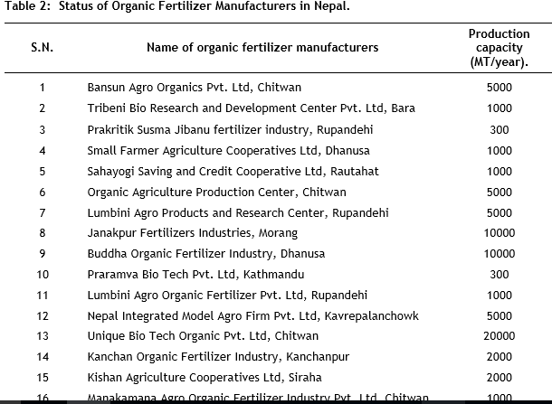

Slide 18
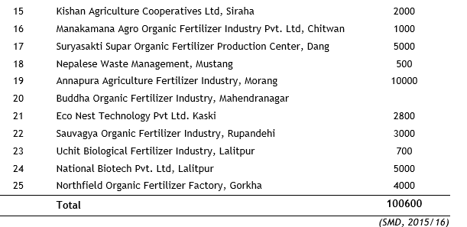

Slide 19
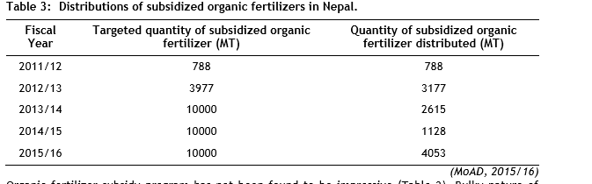

Slide 20
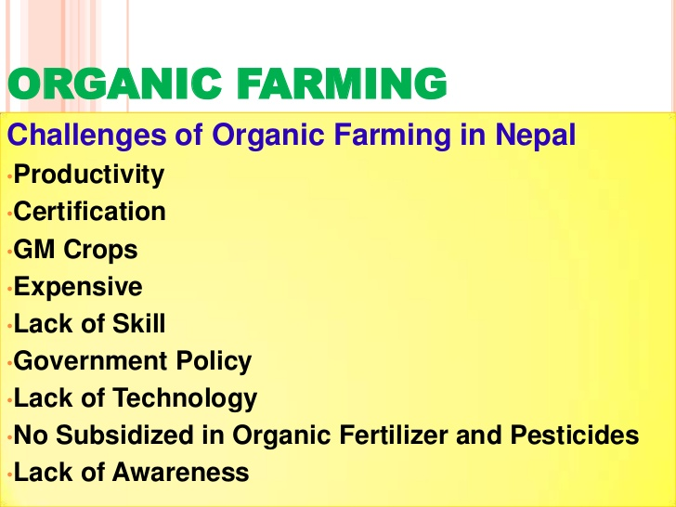

Slide 21
CONCLUSION
Fundamental aspect of organic farming still in Nepal are of traditional type and it will be easier to adopt the organic farming by simple modification
The adoption of organic farming can be an opportunity for rural employment and to alleviate poverty in Nepal
Certification problems are the issues for exporting the organic products of our country.
Lack of effective policies and laws had distorted the expansion of organic agriculture.

Slide 22
THANK YOU

